Slide 1
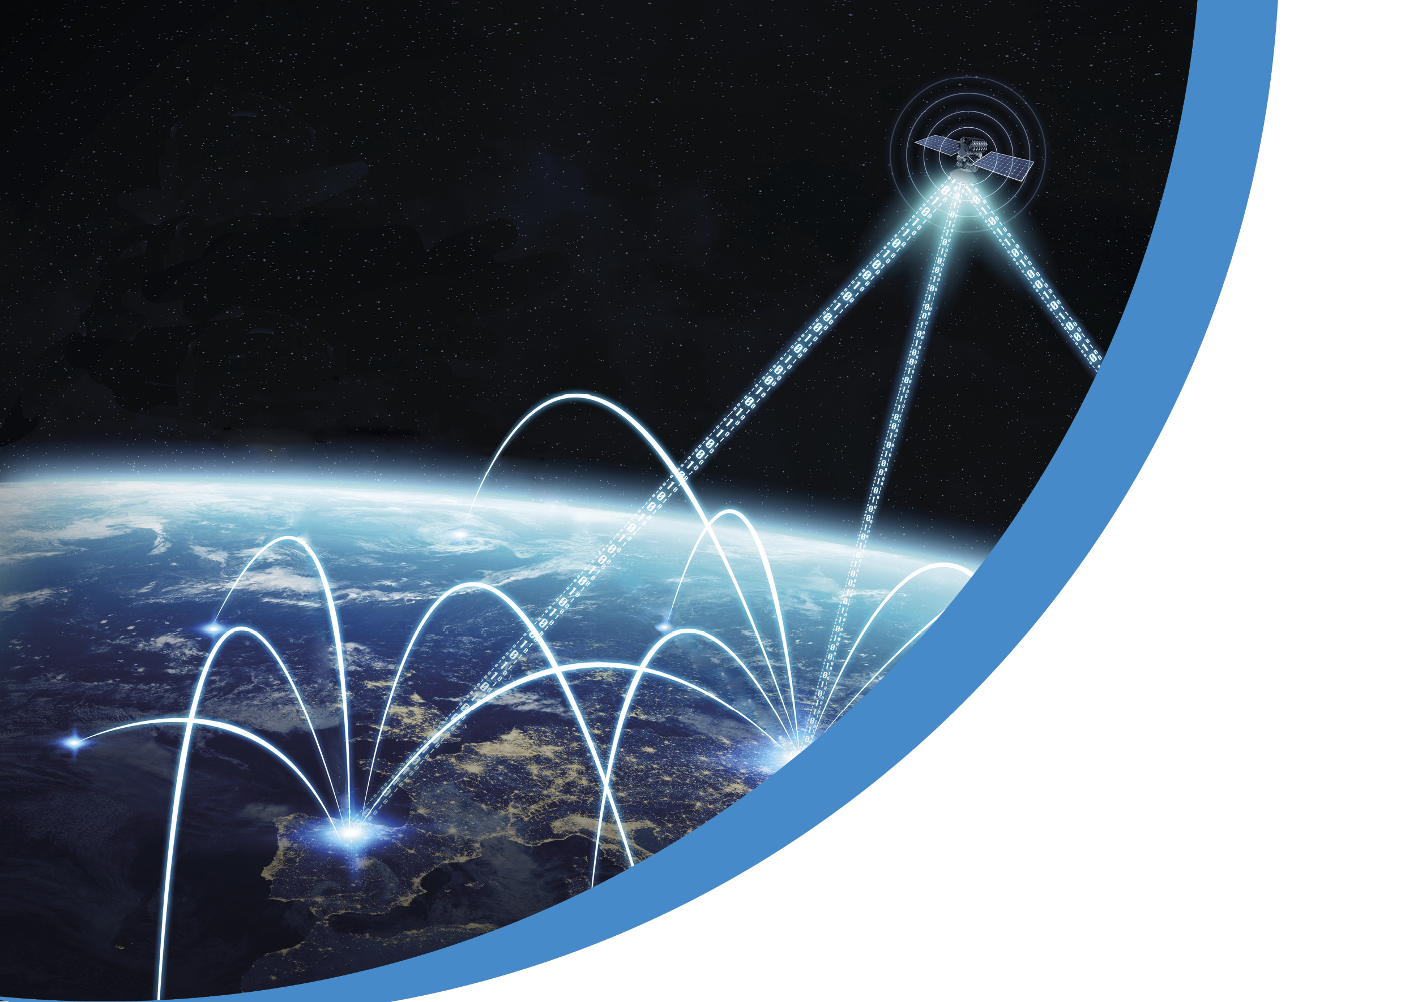



6G-TakeOff
Consortium meeting
26 – 28 April 2023
HANNOVER MESSE
30 March – 04 April, 2025

Slide 2
Research project funded by
on
Holistic 3D Communication Networks for 6G
Combination of ground-based and non-terrestrial execution platforms in a holistic manner as infrastructure for network elements
Research project from 2022 to 2025

Slide 3



















Project Partners: Bringing Industries Together
Applications / Vertical Industries
Network Operators
Aerospace
Micro electronics & SW
Communications
Research and Academia

Slide 4
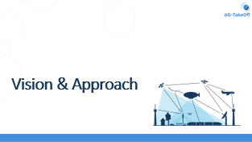
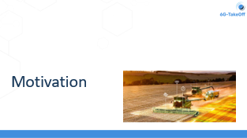

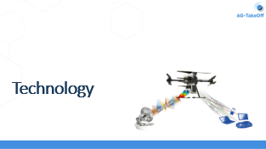
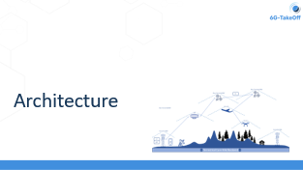

Slide 5
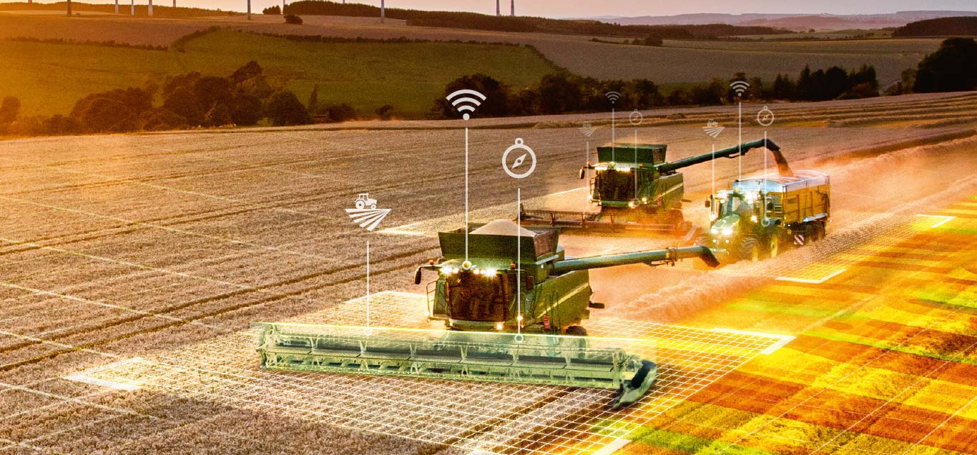
Motivation

Slide 6
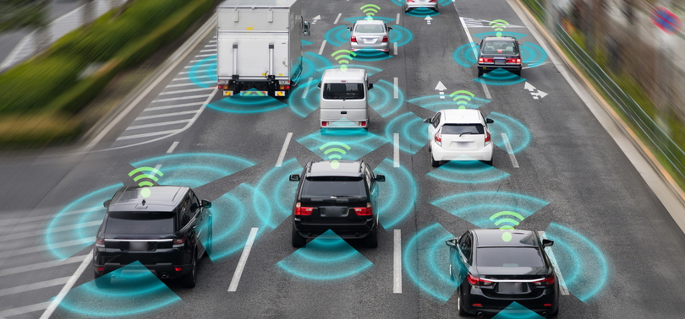

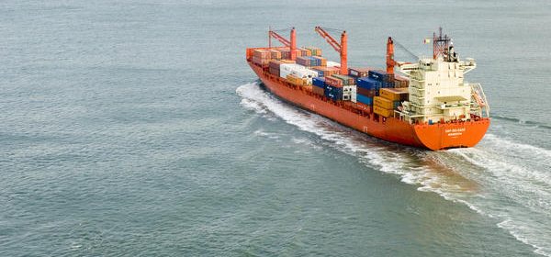
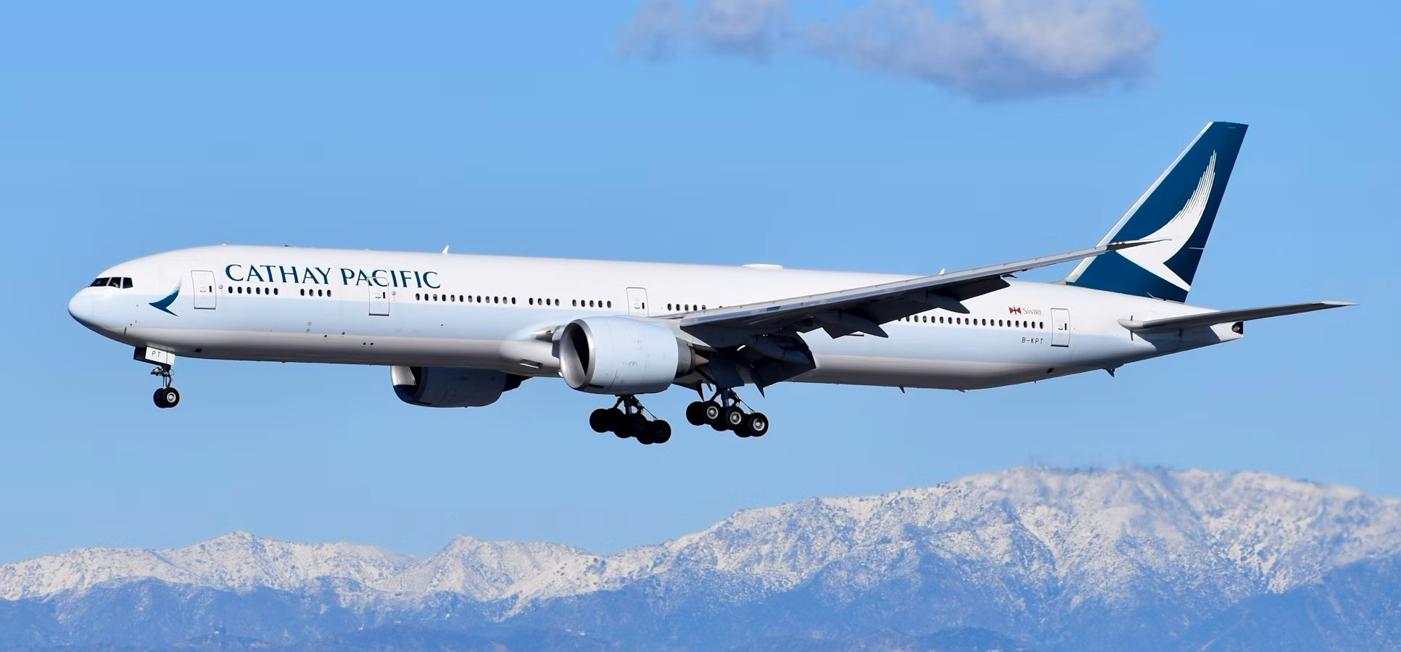
Insufficient Coverage for Mobile Connectivity
Autonomous driving
Coverage of (terrestrial) white spots
Maritime
Aerospace: Passenger aircraft & logistics
Notes:
Automotive Driving: https://bmdv.bund.de/SharedDocs/DE/Bilder/DG/autonomes-fahren-2.jpg?__blob=normal
Coverage of (terrestrial): https://unsplash.com/de/fotos/landschaft-der-berge-oMneOBYhJxY
Martitime: https://stockarch.com/images/transport/container-ship-3823
Aerospace: https://unsplash.com/de/fotos/weisses-passagierflugzeug-fliegt-tagsuber-uber-schneebedeckte-berge-ze09IQjOZhk

Slide 7
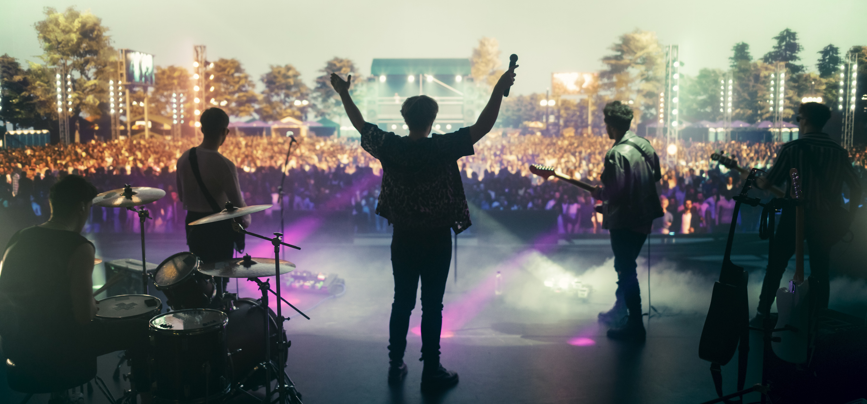
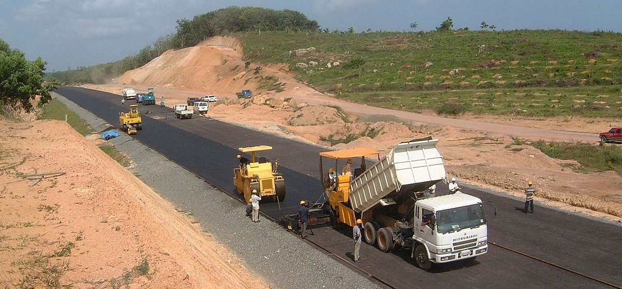
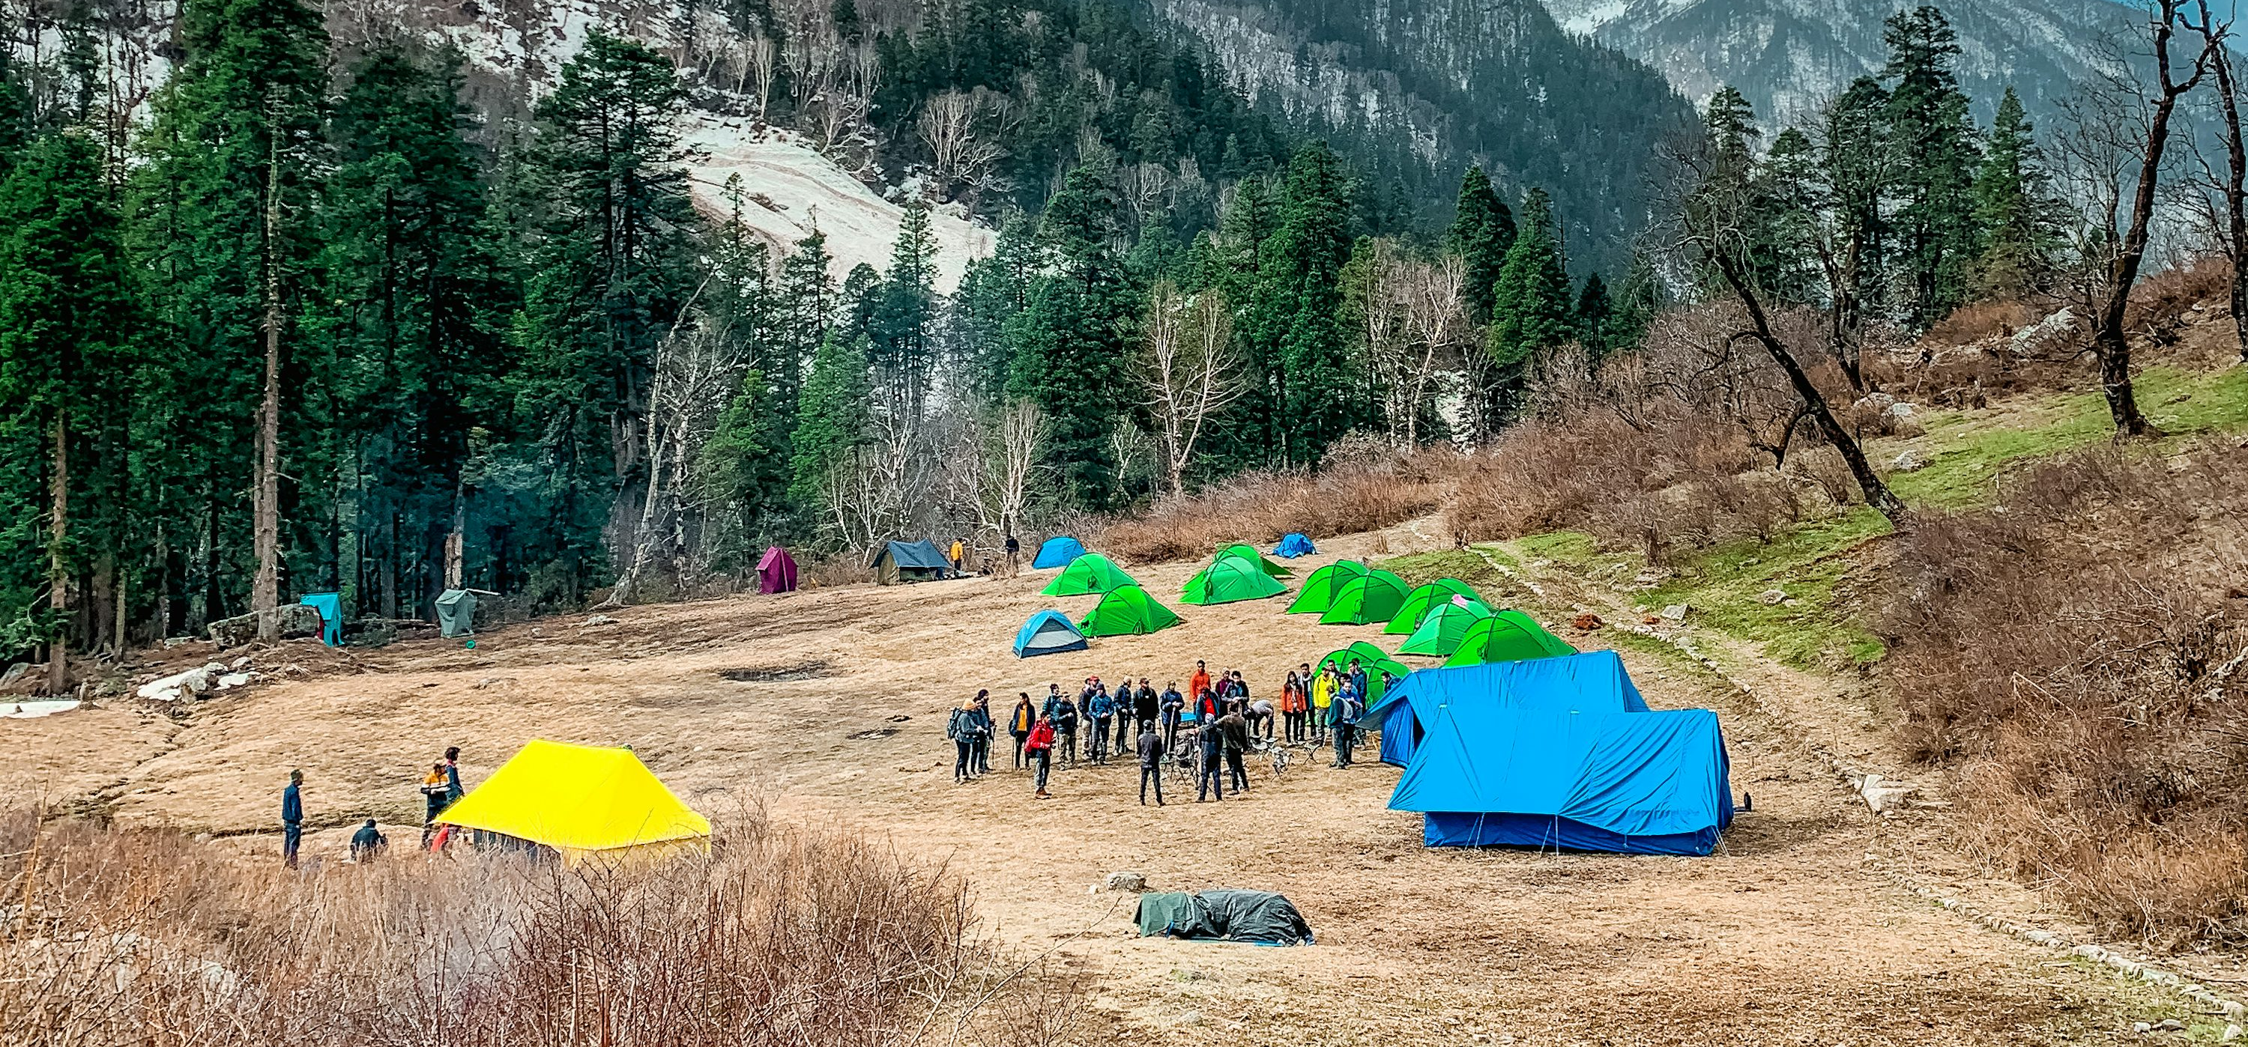
Temporarily / Locally Insufficient Capacity
Agriculture
Cultural and sports events
Construction Areas
Camping
Notes:
Bildquellen:
Agriculture: AutoTrac™: 20 Jahre Präzisionslenkung -- John Deere
Cultural:
https://stock.adobe.com/search/images?filters%5Bcontent_type%3Aphoto%5D=1&filters%5Bcontent_type%3Aillustration%5D=1&filters%5Bcontent_type%3Azip_vector%5D=1&filters%5Bcontent_type%3Avideo%5D=0&filters%5Bcontent_type%3Atemplate%5D=0&filters%5Bcontent_type%3A3d%5D=0&filters%5Bcontent_type%3Aaudio%5D=0&filters%5Bcontent_type%3Aimage%5D=1&filters%5Bfree_collection%5D=0&filters%5Border%5D=relevance&filters%5Binclude_stock_enterprise%5D=0&filters%5Bis_editorial%5D=0&order=relevance&serie_id=&native_visual_search=67e43ffa3a57c&similar_content_id=&model_id=&find_similar_by=all&k=&search_page=1&search_type=visual-search-browse&get_facets=0&asset_id=884239426 <<<< Free trial
https://www.festivall-app.com/en/festivals/open-air-frauenfeld
https://www.magentamusik.de/wacken/woa-2024-livestream
https://stock.adobe.com/search?filters%5Bcontent_type%3Aphoto%5D=1&filters%5Bcontent_type%3Aillustration%5D=1&filters%5Bcontent_type%3Azip_vector%5D=1&filters%5Bcontent_type%3Aimage%5D=1&filters%5Bfree_collection%5D=0&filters%5Border%5D=relevance&k=&order=relevance&limit=100&search_page=1&search_type=usertyped&acp=&aco=music+festival+stage+crowd&serie_id=286942893
Construction Area https://en.wikipedia.org/wiki/File:STDP-SRI_LANKA-DINESH_ALWIS-RDC.jpg
Camping: https://unsplash.com/de/fotos/grunes-und-gelbes-zelt-in-der-nahe-von-grunen-baumen-und-bergen-unter-weissen-wolken-und-blauem-himmel-wahrend-ADKiS6V2Za8

Slide 8
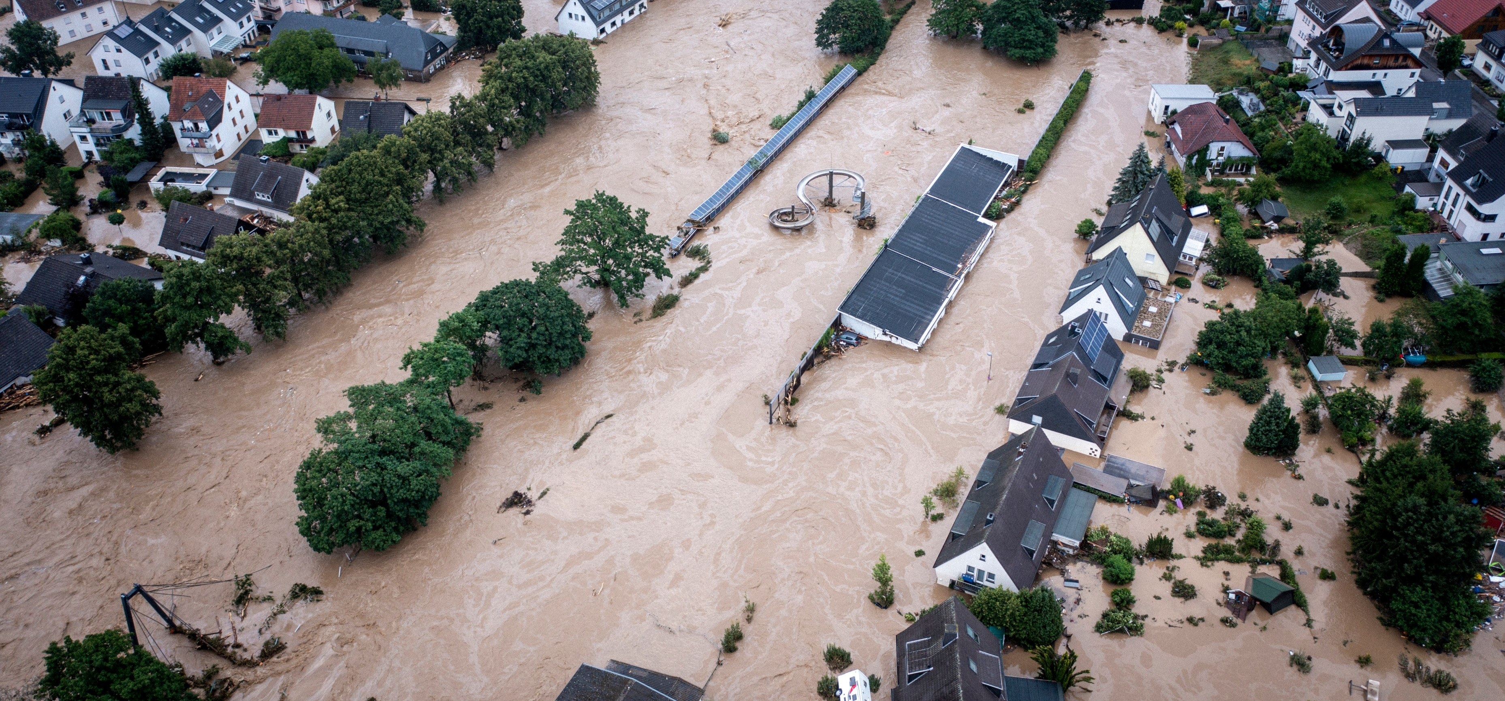

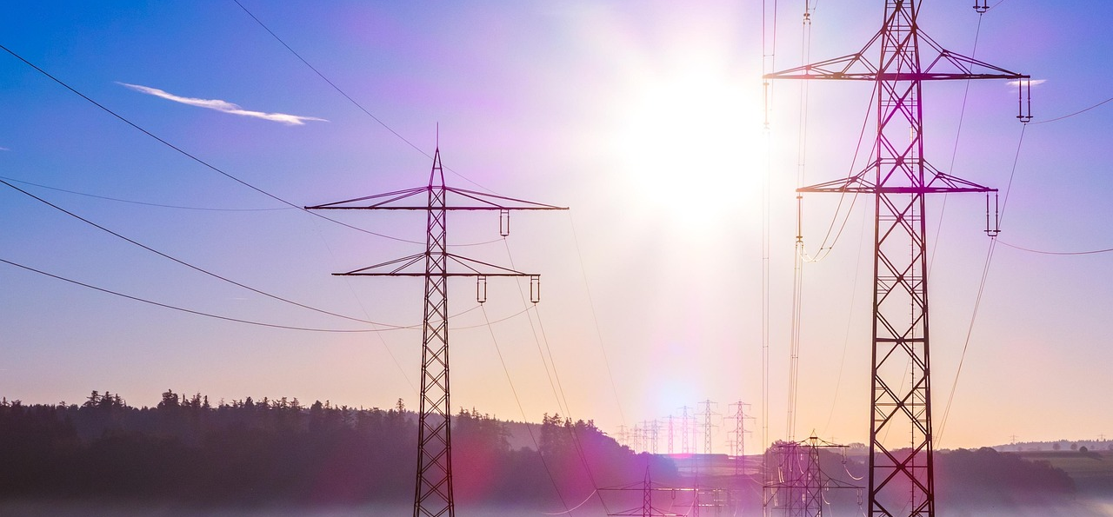
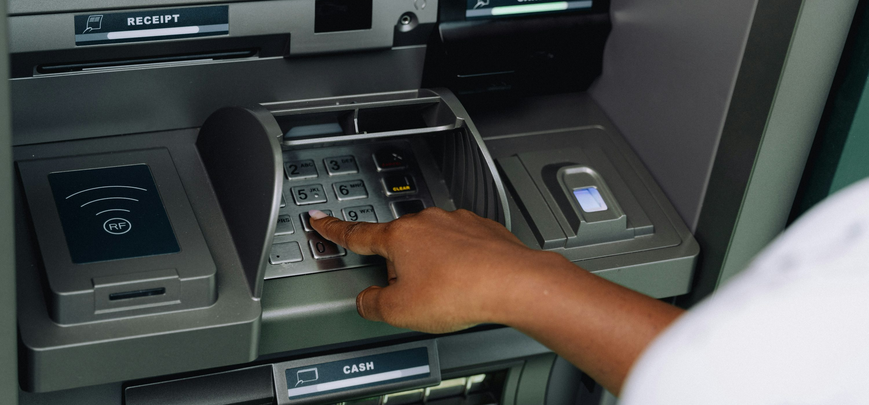
Resilience and Security
Disaster recovery
Public authorities
Operation of critical infrastructure
Banking
Notes:
Bildquellen:
Stromnetz: https://pixabay.com/de/photos/stromleitungen-oberleitungen-503936/
Geldautomat: https://unsplash.com/de/fotos/eine-person-die-einen-geldautomaten-benutzt-um-geld-zu-bezahlen-OnRPps1wPus
Polizei: https://rhein-erft-kreis.polizei.nrw/sites/default/files/2020-02/IMNRW-200219-012.jpg

Slide 9

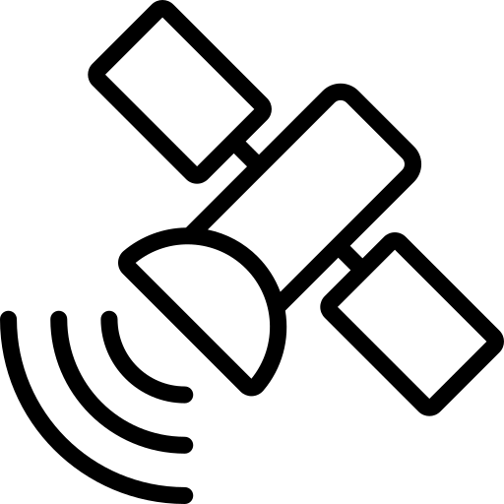






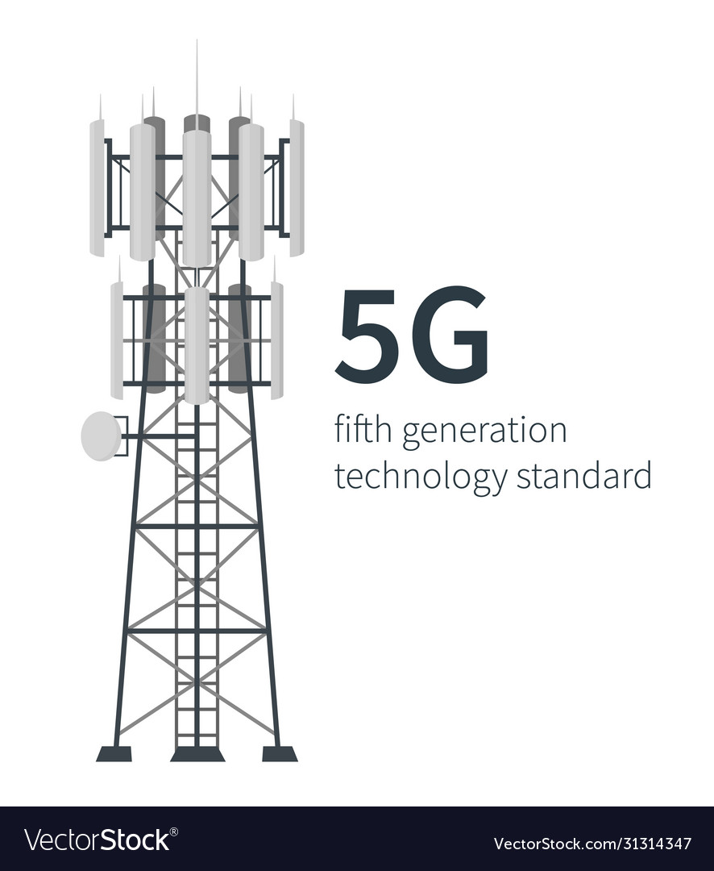









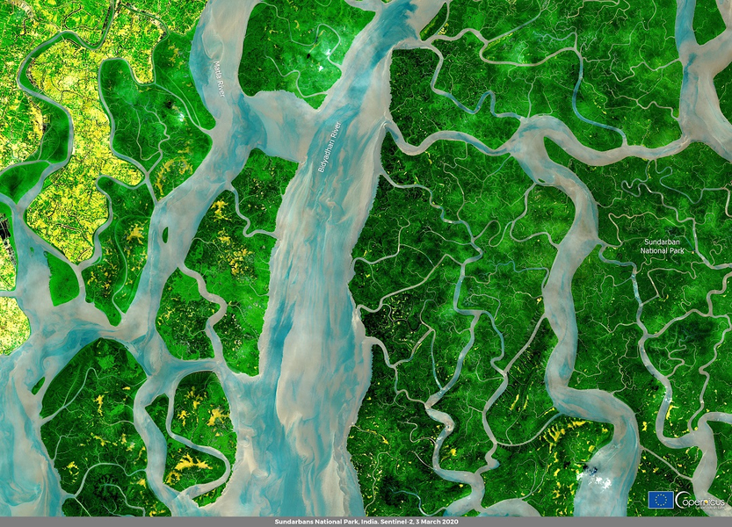
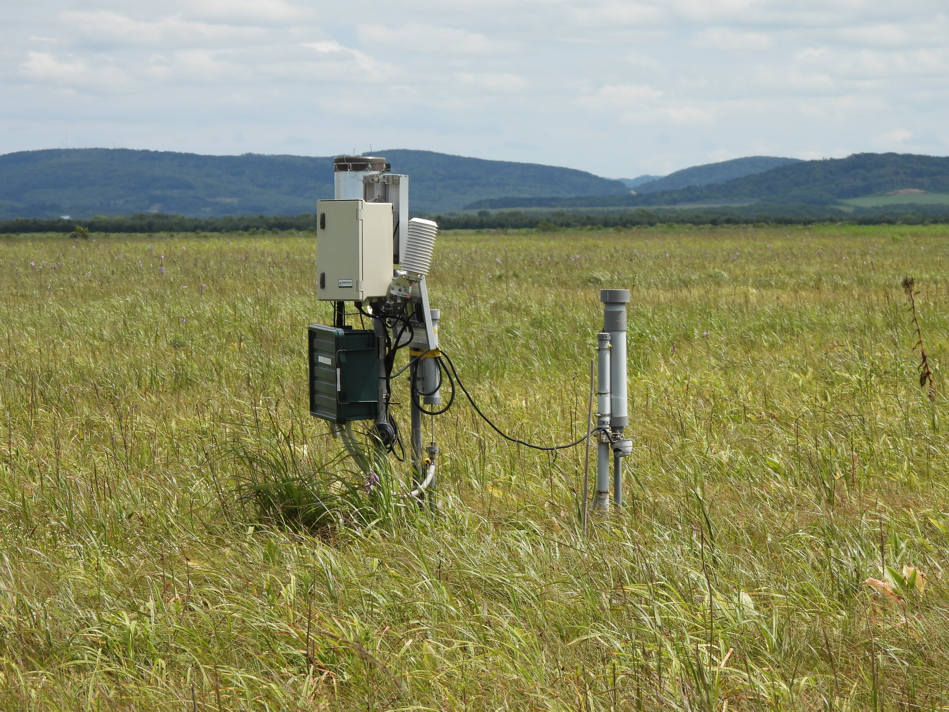
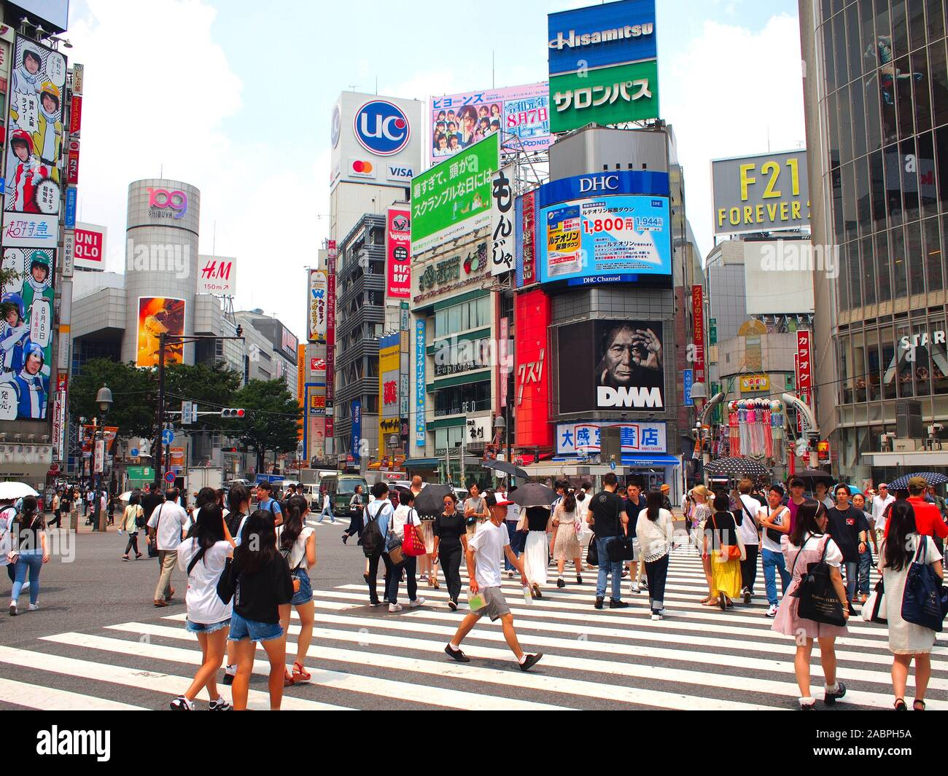
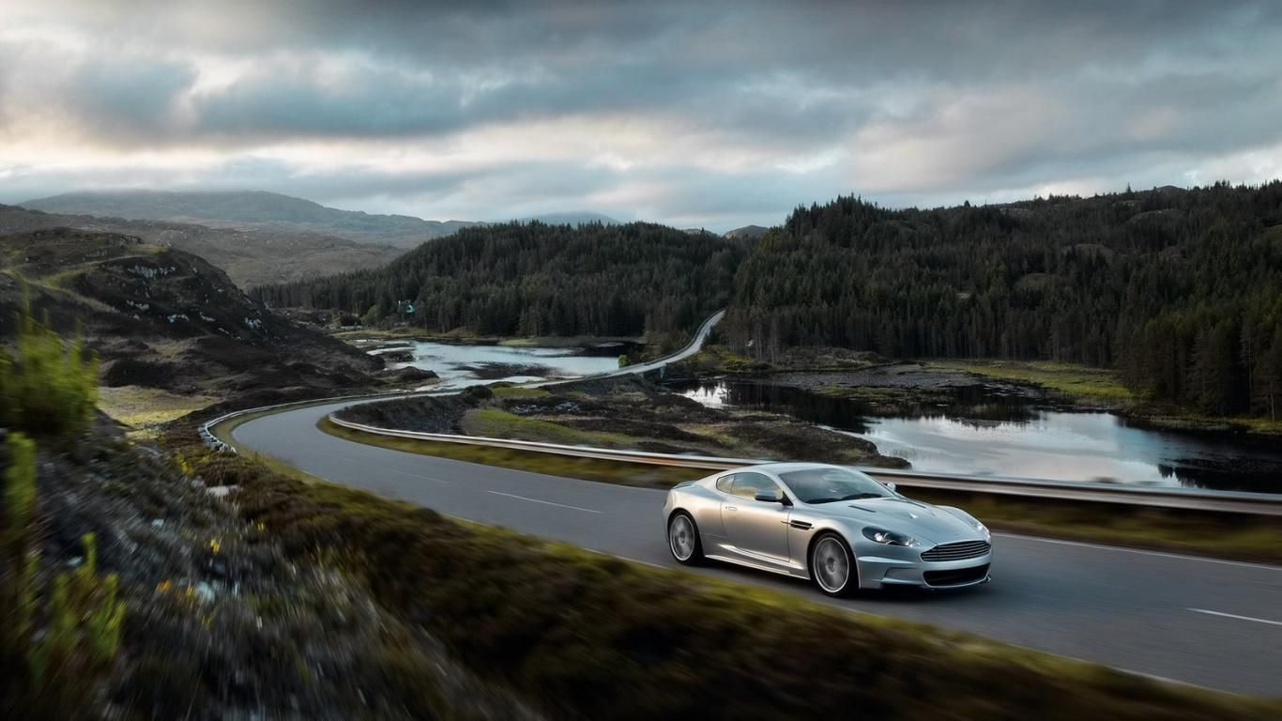
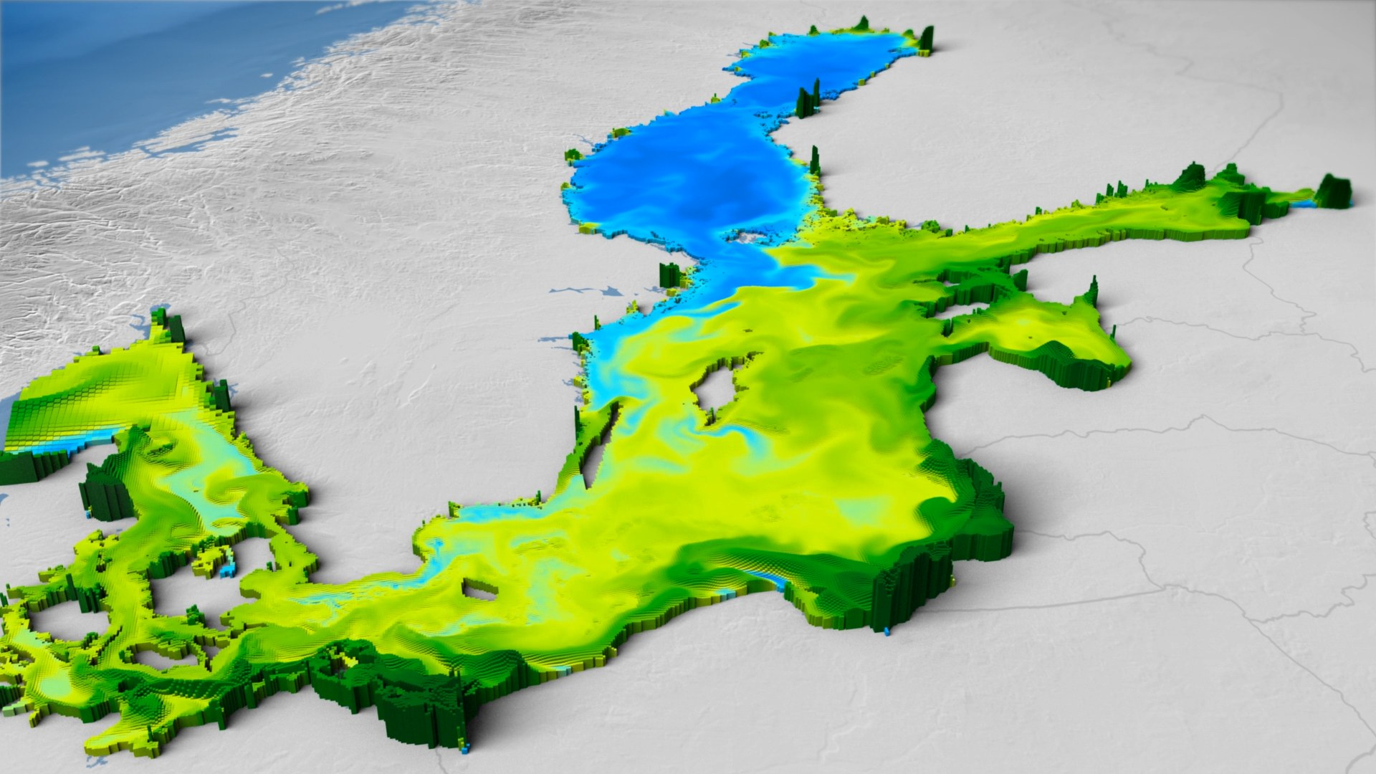
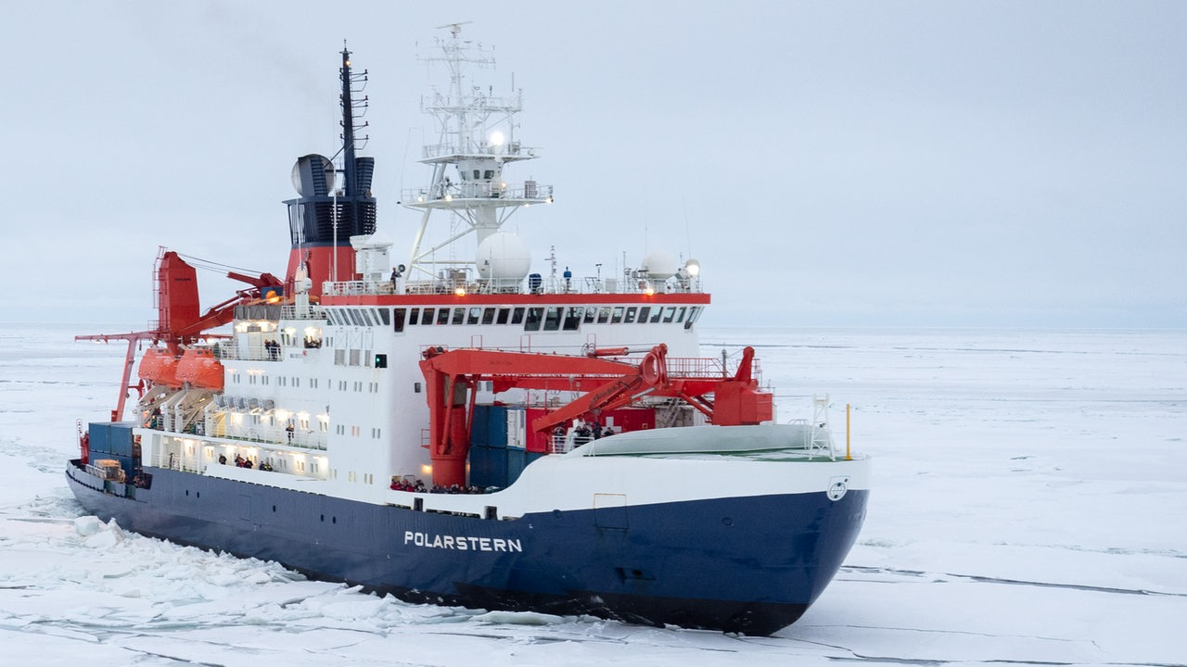
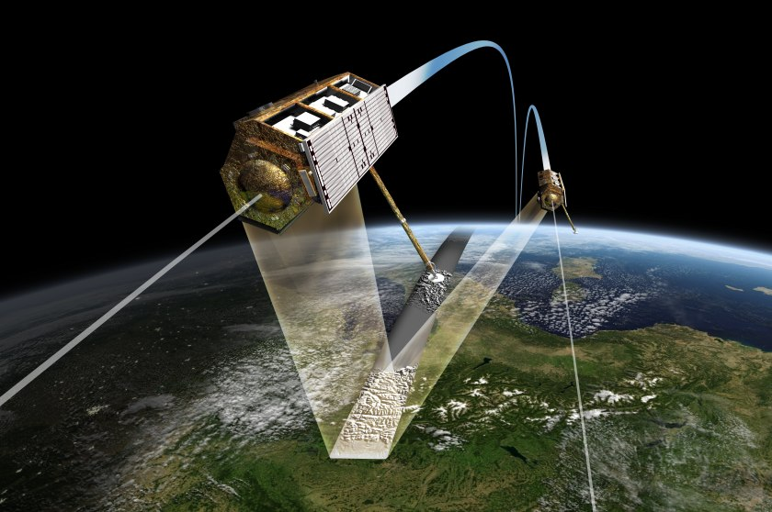
The Need for 3D
Space Segment
GEO
GEO
MEO
Global connectivity enabling advanced use cases
with high social and economical impact
LEO
LEO
Connecting
Rural Areas
Resilience Communication Infrastructure
Autonomous Driving and Transportation
Fast Train
Support
Intelligent
Farming
World-wide Logistics
Maritime Connectivity
Health
support
Earth Observation & Environmental Monitoring
Governmental Services
Stock Exchange Networks
(Security)
Airline
Connectivity
Air Segment
Airship
HAP
Aircraft
UAVs
Ground Segment
Buoy
Ship
Automotive
Sensor
Base station
Train
Rover
Earth station

Slide 10
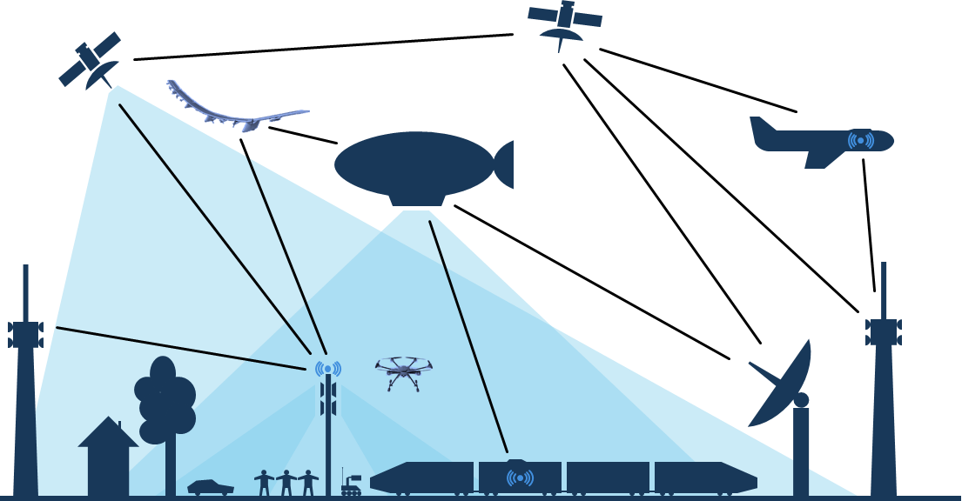
Vision & Approach

Slide 11

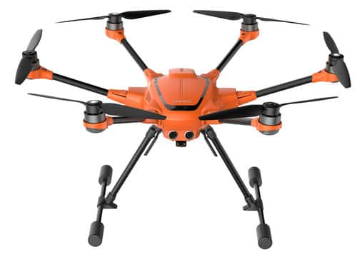
3D Networks
Combining mobile communication sector, aerospace sector
Combining mobile communication sector, aerospace sector, and space sector
Combining mobile communication sector
G
F
F
H
3
B
D
F
E
C
2
A
D
1
Combine ground-based and non-terrestrial execution platforms
Seamless connectivity everywhere and anytime
Flexible and demand-oriented provisioning of network capacity
Fully exploit potential of network sites on different altitudes
Notes:
Bildquelle:
https://stock.adobe.com/search?filters%5Bcontent_type%3Aphoto%5D=1&filters%5Bcontent_type%3Aillustration%5D=1&filters%5Bcontent_type%3Azip_vector%5D=1&filters%5Bfree_collection%5D=0&filters%5Bcontent_type%3Aimage%5D=1&filters%5Border%5D=relevance&k=satellite+communication&order=relevance&limit=100&search_page=1&search_type=freebr-asset-click&acp=0&aco=satellite+communication&asset_id=121901299

Slide 12
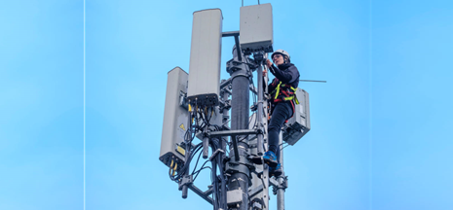
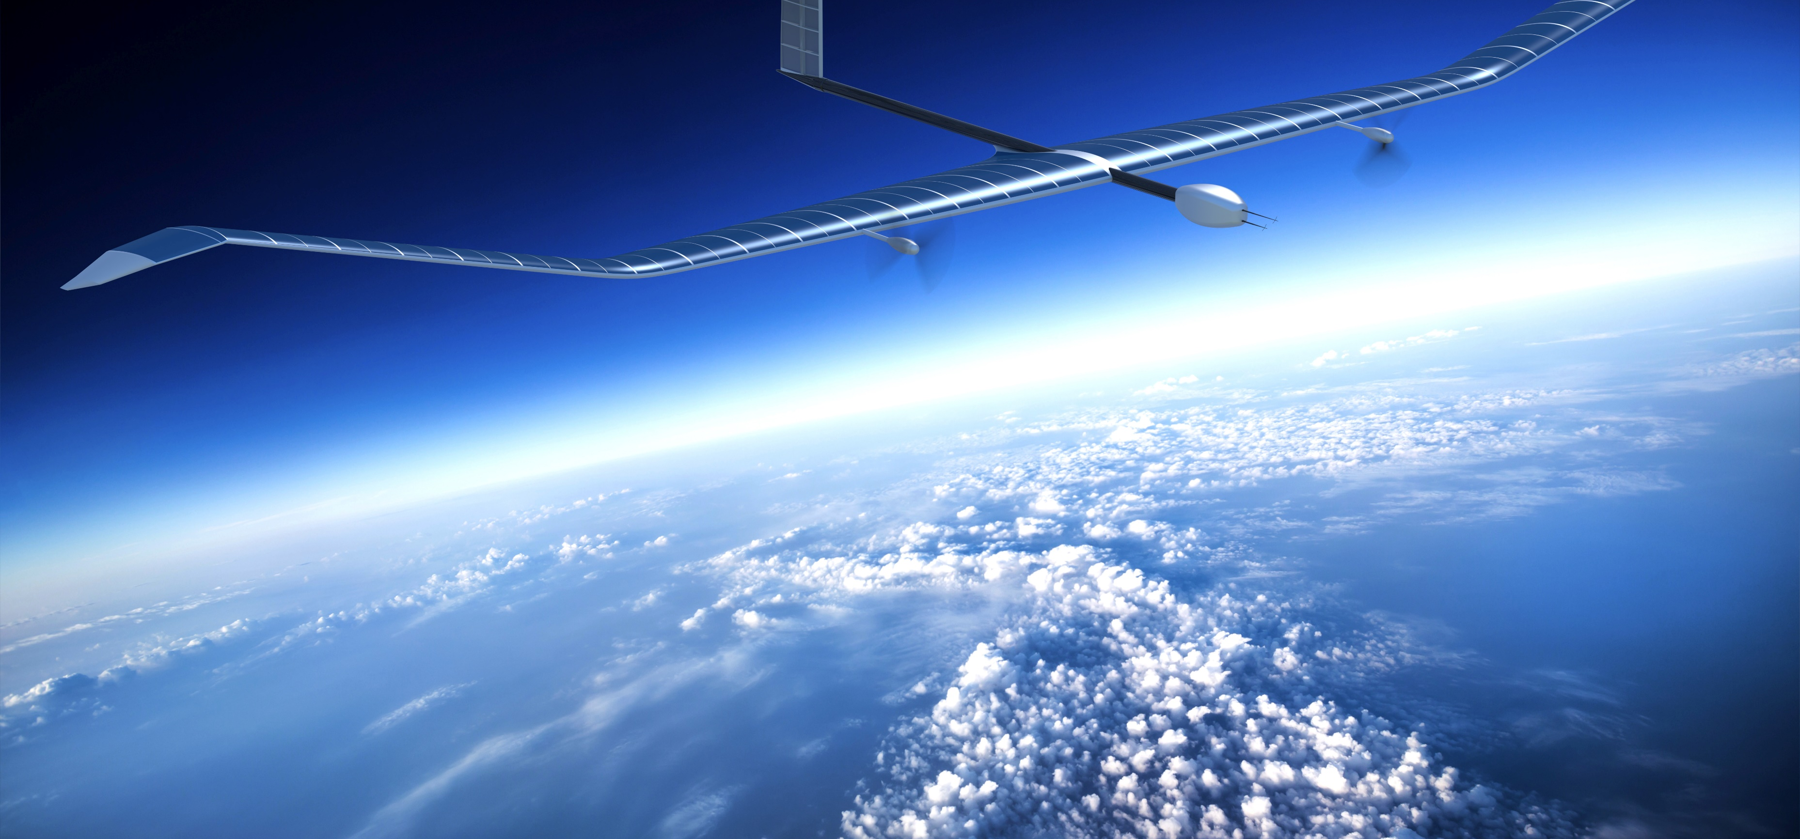
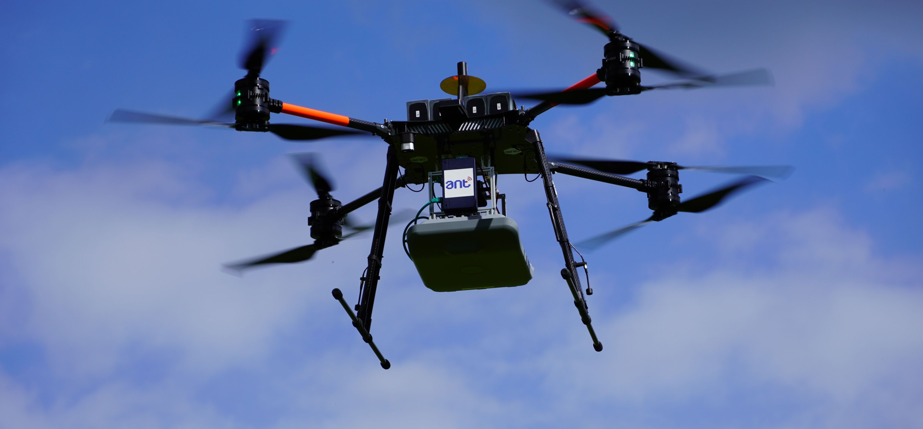
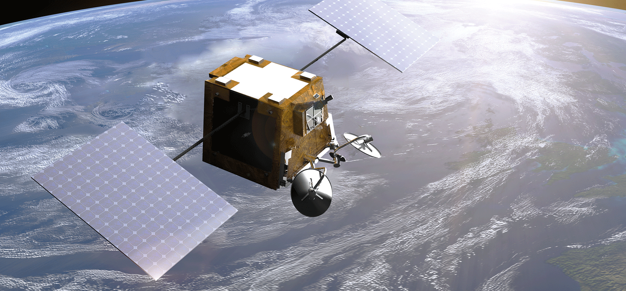
Connecting the Unconnected: Global Coverage
Terrestrial Base Station
High-Altitude Platforms
Base Station on Drones
Satellites
Notes:
Bildquellen:
Mobilfunkantenne: https://commons.wikimedia.org/wiki/File:Mobilfunkantennenanlage.jpg
UAV: https://www.airbus.com/en/products-services/defence/uas/zephyr
Satellit: https://www.airbus.com/en/newsroom/press-releases/2022-07-airbus-to-provide-42-satellite-platforms-and-services-to-northrop

Slide 13
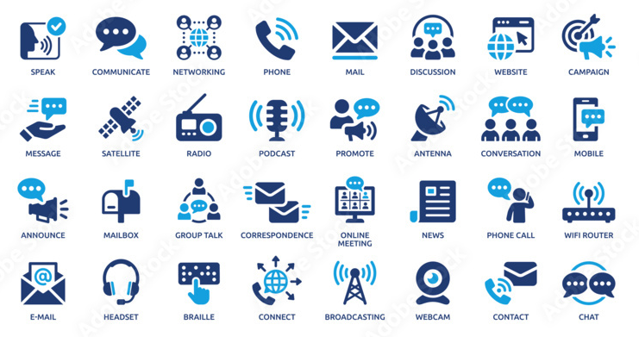

One Device Only
Single User Device for all Network Types
No need for multiple user terminals
Low terminal complexity and cost
by unified network technology
Cost reduction by larger customer base for terminal manufacturers
No customer lock-in to proprietary networks
Notes:
Bildquellen:
https://mediamag.mediamarkt.at/detail/smartphone-ai-ki-huawei-p20-pro.html ---> iStock https://www.istockphoto.com/de/foto/ki-und-smart-factory-abstrakte-mischtechnik-gm875477964-244408680?searchscope=image%2Cfilm

Slide 14
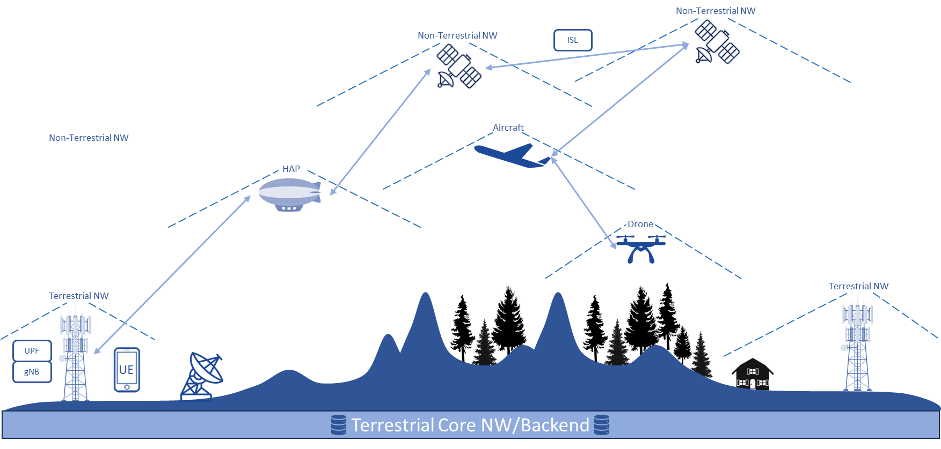
Architecture

Slide 15
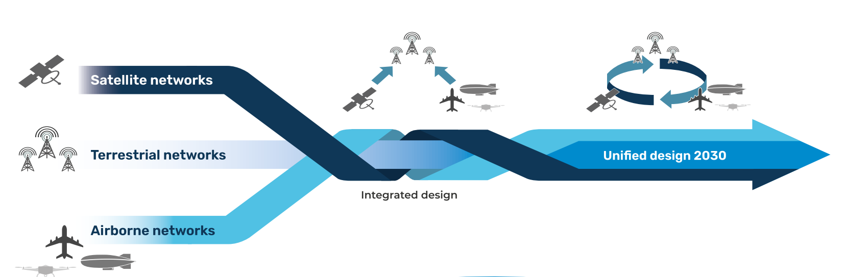
Unification towards a Common 3GPP Standard
Holistic design approach with terrestrial nodes, drones, airplanes, and satellites
4G & Before
5G & B5G
6G & beyond
© Copyright Airbus Defence and Space GmbH 2022

Slide 16
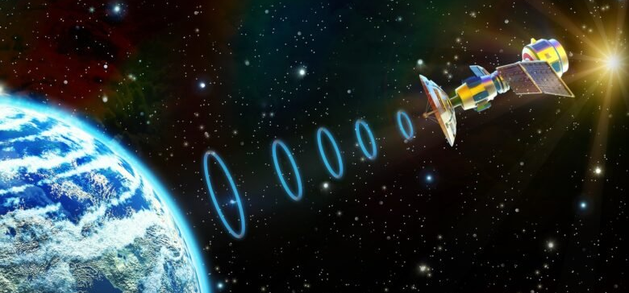
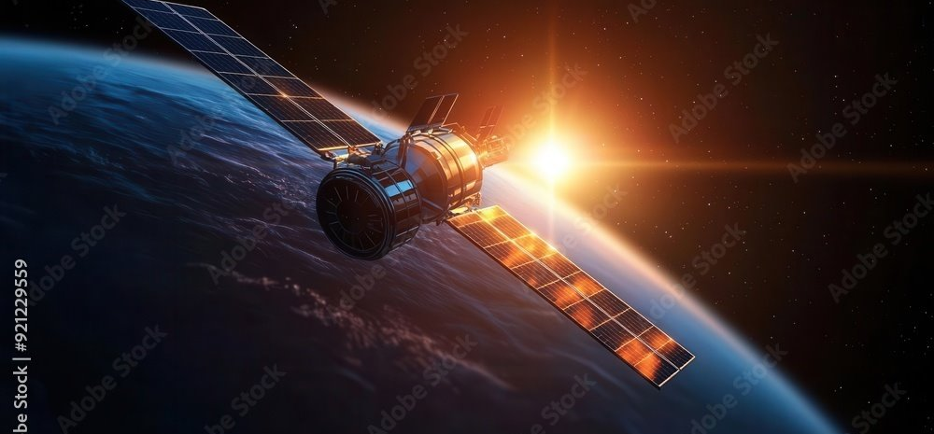


Physical Challenges for 3D Networks
Latency and low data throughput
Power Generation and Storage
Harsh space environment
Crowded satellite spectrum
Notes:
Bildquellen
Latency: https://stock.adobe.com/search?creator_id=204731649&filters%5Bcontent_type%3Aphoto%5D=1&filters%5Bcontent_type%3Aillustration%5D=1&filters%5Bcontent_type%3Azip_vector%5D=1&filters%5Bcontent_type%3Avideo%5D=1&filters%5Bcontent_type%3Atemplate%5D=1&filters%5Bcontent_type%3A3d%5D=1&filters%5Bcontent_type%3Aaudio%5D=0&filters%5Binclude_stock_enterprise%5D=0&filters%5Bis_editorial%5D=0&filters%5Bfetch_excluded_assets%5D=1&filters%5Bcontent_type%3Aimage%5D=1&order=relevance&limit=100&search_page=3&search_type=pagination&get_facets=0&asset_id=63005787 <<<< Free trial license
Strahlung: https://stock.adobe.com/search/images?filters%5Bcontent_type%3Aphoto%5D=1&filters%5Bcontent_type%3Aillustration%5D=1&filters%5Bcontent_type%3Aimage%5D=1&filters%5Border%5D=relevance&k=space+solar+radiation+particle&order=relevance&limit=100&search_page=1&search_type=usertyped&acp=&aco=space+solar+radiation+particle&get_facets=1&asset_id=1303083848 <<<< Free trial license
Energie:
https://stock.adobe.com/search?filters%5Bcontent_type%3Aphoto%5D=1&filters%5Bcontent_type%3Aillustration%5D=1&filters%5Bfree_collection%5D=0&filters%5Bcontent_type%3Aimage%5D=1&filters%5Border%5D=relevance&k=satellite+sunlight&order=relevance&limit=100&search_type=freebr-asset-click&search_page=1&acp=&aco=satellite+sunlight&asset_id=921229559 <<< Free trial license
https://www.istockphoto.com/de/foto/satelliten-in-den-strahlen-der-aufgehenden-sonne-gm680511642-124724223
https://www.istockphoto.com/de/foto/raum-satelliten-%C3%BCber-den-planet-earth-gm485707614-72212023
Frequenzen:
https://stock.adobe.com/search/images?filters%5Bcontent_type%3Aphoto%5D=1&filters%5Bcontent_type%3Aillustration%5D=1&filters%5Bcontent_type%3Azip_vector%5D=1&filters%5Bcontent_type%3Avideo%5D=0&filters%5Bcontent_type%3Atemplate%5D=0&filters%5Bcontent_type%3A3d%5D=0&filters%5Bcontent_type%3Aaudio%5D=0&filters%5Bfree_collection%5D=0&filters%5Bcontent_type%3Aimage%5D=1&filters%5Binclude_stock_enterprise%5D=0&filters%5Bis_editorial%5D=0&order=relevance&serie_id=216979468&search_page=2&get_facets=0&search_type=pagination&asset_id=220166364 <<< Free trial license
https://www.jammer-welt.com/interferenz-von-alarmen-auf-frequenzen-433-868MHz.html

Slide 17
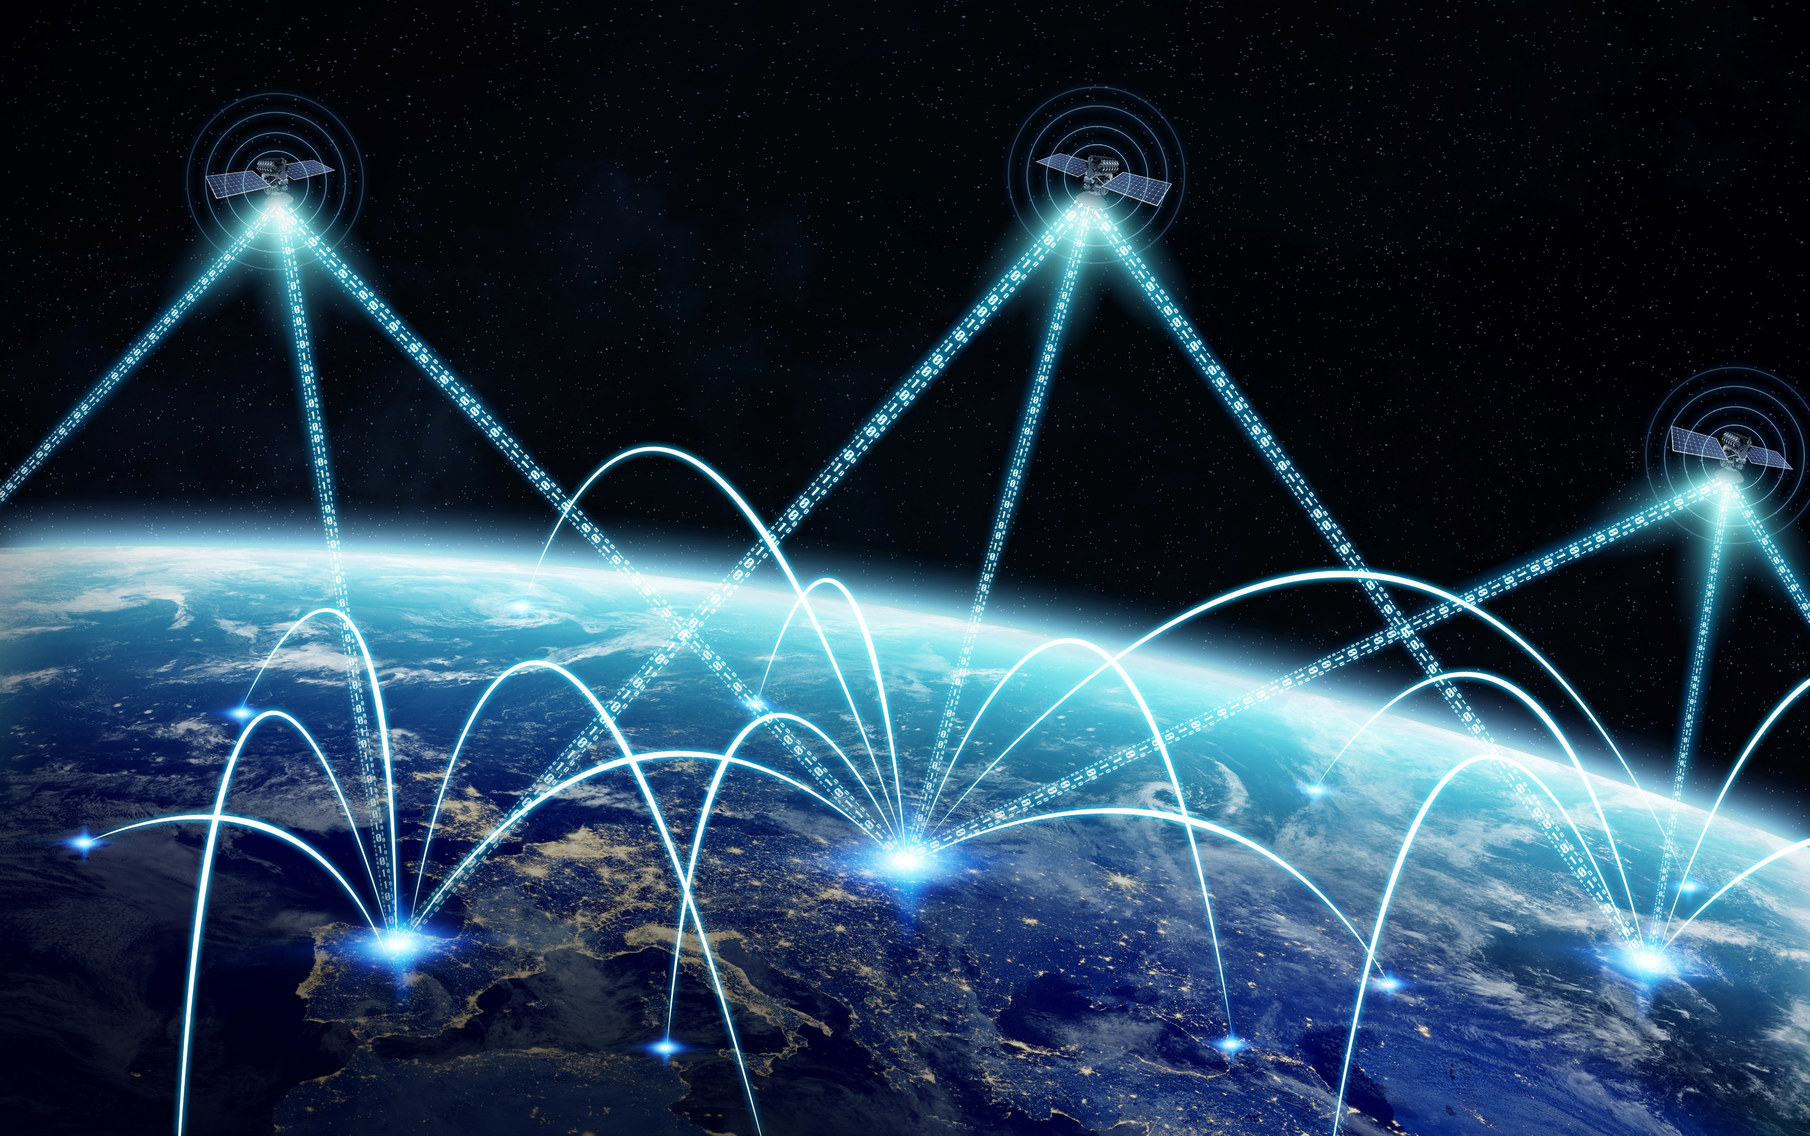
Expanding the Internet into Space
Satellites cross Germany is less than 5 minutes
High network dynamic requires rapid adaptation of network routes
Approach: Virtualization allows to separate network functionality from satellites
  Virtual network functionality practically stationary
  Relocation of base stations on satellites as virtual machines preserving transport network connections for 3GPP interfaces
Notes:
Bildquelle:
https://www.dlr.de/de/rb/forschung-betrieb/missionen/kommunikation/edrs → ESA
https://pixabay.com/de/illustrations/ai-generiert-internet-technologie-8166816/ <<<- Kostenlos

Slide 18





3D Network
User is served by terrestrial base station in urban areas
Base Station-TN
Base Station-TN
Ground Station-TN
UPF
UE
gNB
Base station
Base station
Terrestrial Core NW/Backend
Notes:
First scenario: UE is connected to a terrestrial network covered area. The UPF and gNB are virtualized instances on the local terrestrial network

Slide 19

3D Network
Satellite-NTN
Satellite-NTN
ISL
User is served by satellite base station in rural areas
UPF
gNB
Via inter-satellite link (ISL) the serving satellite is connected to the core network
Base Station-TN
UE
Base Station-TN
Ground Station-TN
Base station
Base station
Terrestrial Core NW/Backend
Notes:
This slide introduces the concept of 3D communication networks in 6G which integrate terrestrial, aerial and space-based networks. In this scenario, the UE is now moving to a remote/rural area not covered by Terrestrial Networks.
As this approach ensures global coverage and enhances network capacity to guarantee seamless connectivity, now, the UE is accessing a non-terrestrial network via one visible satellite connection. This satellite, in turn, links to another visible satellite via Inter-Satellite link that is connected to a ground station linked to the core network.
The virtul sessions of the 3GPP network functions are handed over to the NTN from the TN to maintain the user experience.

Slide 20
3D Network
Satellite-NTN
Satellite-NTN
ISL
Moving user is served by another satellite
UPF
gNB
Base Station-TN
UE
Base Station-TN
Ground Station-TN
Base station
Base station
Terrestrial Core NW/Backend
Notes:
Next, as the UE and the satellite are moving, the UE is connecting to the core network via the second satellite as it is now visible from the UE

Slide 21
3D Network
Satellite-NTN
Satellite-NTN
ISL
High Altitude Platforms (HAPs) provides access
Aircraft-NTN
HAP-NTN
gNB
Drone-NTN
Base Station-TN
Base Station-TN
UPF
Ground Station-TN
UE
Base station
Base station
Terrestrial Core NW/Backend
Notes:
Again, the UE is moving and the satellite 2 is out of its line of sight so it is connecting to a High Altitude Platform (HAP), in this case a balloon that is offering access to the core network via terrestrial base station. As we can see in this schematic, there are several non-terrestrial nodes interconnected between them that ensure always uninterrupted seamless service.
Highlight also, in this case, that whereas the gNB function is located in the NTN HAP, the UPF function can be placed, for instance, on ground. This is a key aspect of the 3D network deployment as the UPF and gNB are virtualized Network functions that are moving with the UE to maintain the user experience. This functions virtualization basically consist in distributing the computing and processing tasks between terrestrial and non-terrestrial nodes in order to optimize network performance, improve efficiency and reduce the dependence of just terrestrial or non-terrestrial networks.

Slide 22
3D Network
Satellite-NTN
Satellite-NTN
ISL
User is again served by terrestrial network
Aircraft-NTN
HAP-NTN
Drone-NTN
Base Station-TN
Base Station-TN
UPF
Ground Station-TN
gNB
UE
Base station
Base station
Terrestrial Core NW/Backend
Notes:
In the last scenario, the UE is connecting back to a terrestrial network covered area. Again, in this scenario, the gNB function is moving with the UE and in this case this function will be provided by the terrestrial base station.

Slide 23



3D Networks: Threads
Non-Terrestrial NW
Non-Terrestrial NW
ISL
Problem: A larger number of wireless communication links increase risk of
Signal disruption: Jamming links
Interception & Manipulation:
Attackers can eavesdrop communication
Supply Chain Risks: Software vulnerabilities may compromise network
Non-Terrestrial NW
Aircraft
HAP
Malicious
Drone
Drone
Terrestrial NW
Terrestrial NW
UPF
UE
gNB
UE
Base station
Base station
Terrestrial Core NW/Backend
Notes:
Signal disruption: Wireless signals can be intentionally disrupted using jamming attacks. Attackers can use radio interference to degrade or completely block communication. This can be particularly critical in NTNs where links rely on satellite connection.
Interception & Manipulation: Wireless communication is inherently more vulnerable to eavesdropping than wired networks. Unencrypted data transmission can be captured by attackers. Even if data is encrypted, they can be stored for later cryptanalysis, so strong encryption algorithms are key.
Supply Chain Risks: Many wireless networks depend on complex software stacks, which can introduce vulnerabilities. Examples include backdoors in network equipment, firmware vulnerabilities, or insecure software updates. Since satellites are also harder to access, fixing issues might also be difficult.

Slide 24

3D Networks: Security from Design to Deployment
Non-Terrestrial NW
Non-Terrestrial NW
ISL
Solution
Full HW and SW Lifecycle Management and Security
Automated Security Assessments
  Penetration Tests
  Vulnerability Scans
Cyber-Resilience: AI-driven anomaly detection and recovery
Non-Terrestrial NW
Aircraft
HAP
Malicious
Drone
Drone
Terrestrial NW
Terrestrial NW
UPF
UE
gNB
UE
Base station
Base station
Terrestrial Core NW/Backend
Notes:
Security must be integrated throughout the entire lifecycle of hardware and software: Design Phase, Deployment Phase, Operation & Maintenance, End-of-Life Management.
Automated Security Assessments: Continuous security monitoring using automated tools to detect threats.
Penetration Tests: Simulated cyberattacks to uncover vulnerabilities.
Vulnerability Scans: Automated scanning tools to identify software and network vulnerabilities.
Cyber-Resilience: AI-driven security systems to detect unusual behavior in networks, flagging potential attacks. AI models can learn normal traffic patterns and identify deviations, such as sudden spikes in data transmission(DDoS) or unexpected network reconfigurations (possible intrusion)

Slide 25
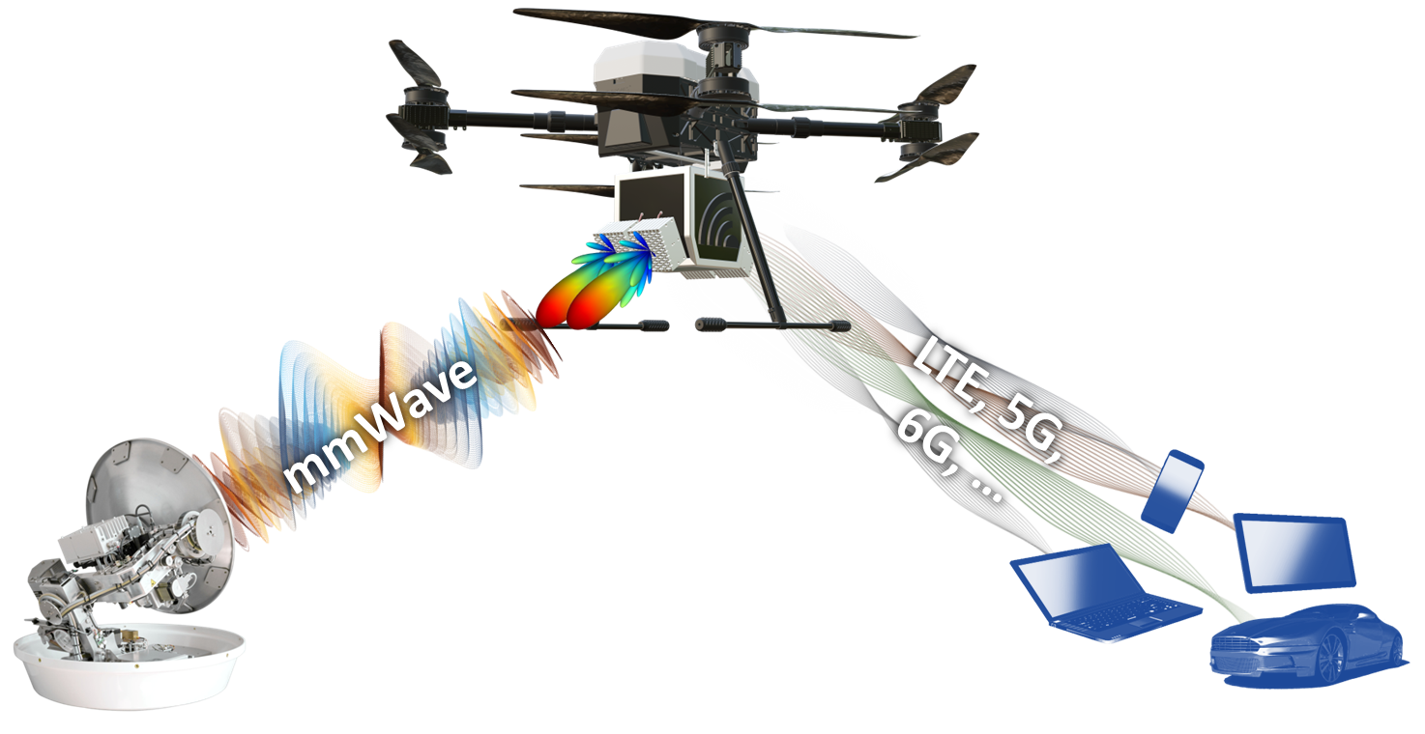
Technology

Slide 26
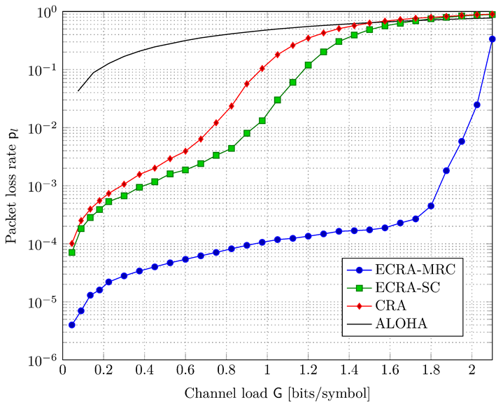


Grant-free access technology for IoT via Satellite
Massive Grant-free access is missing in 5G
  In 5G grant-free access can serve only a limited number of IoT sensors
  In 5G, the waveform and access policy are optimized for TN and only adapted to NTN
What is new
  Our grant-free access technology can serve a massive number of IoT sensors
  The waveform and access policy is optimized for NTN
# of sensors
Receiver
Wireless UMAC channel

Slide 27
Steerable Antenna Systems for UAVs
Challenging requirements for beamforming antennas, UAV tracking algorithms, on-board units:
  Light-weight
  Energy-efficient
  Resistant to adverse environment
Challenging requirements for
ground stations:
  Low price point
  High pointing accuracy and directivity
  Fault and tamper resistant

Slide 28
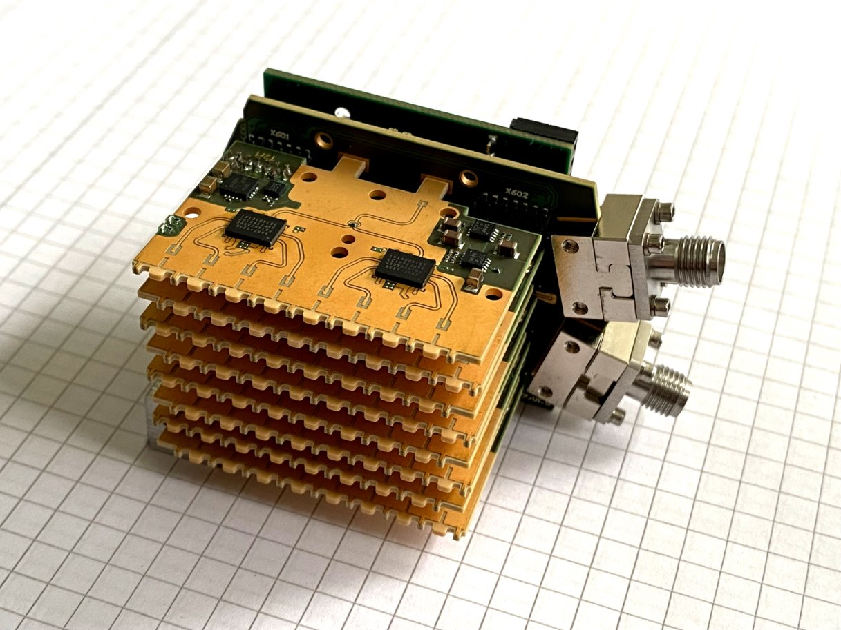
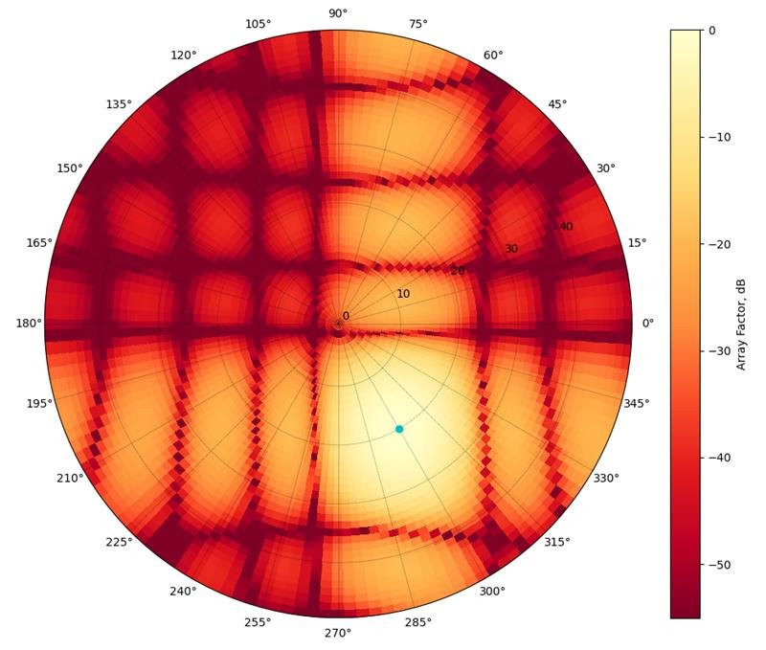
Antennas and RF frontend
mmWave phased array antenna for LAPS/HAPS
Innovative brick structure (matrix of antennas)
Precise control of phase and amplitude of
individual antenna elements
RF frontend based on commercial off-the- shelf components
Signal-to-noise ratio (SNR) of 25 dB over 25km
Communication link | Frequency band
Air-to-ground (downlink) | 38 – 38.3 GHz
Ground-to-air (uplink) | 39.2 – 39.5 GHz

Slide 29
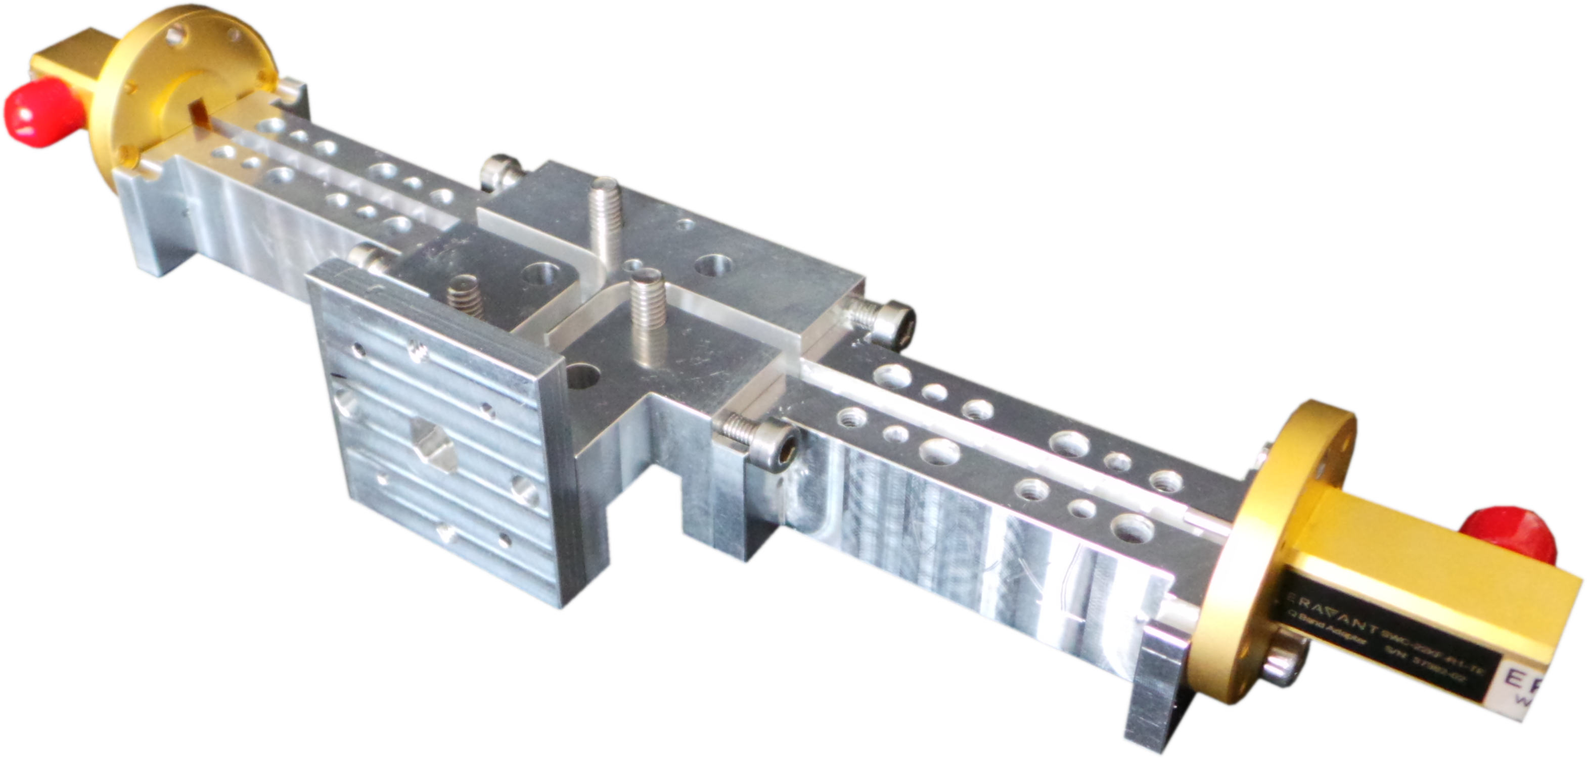
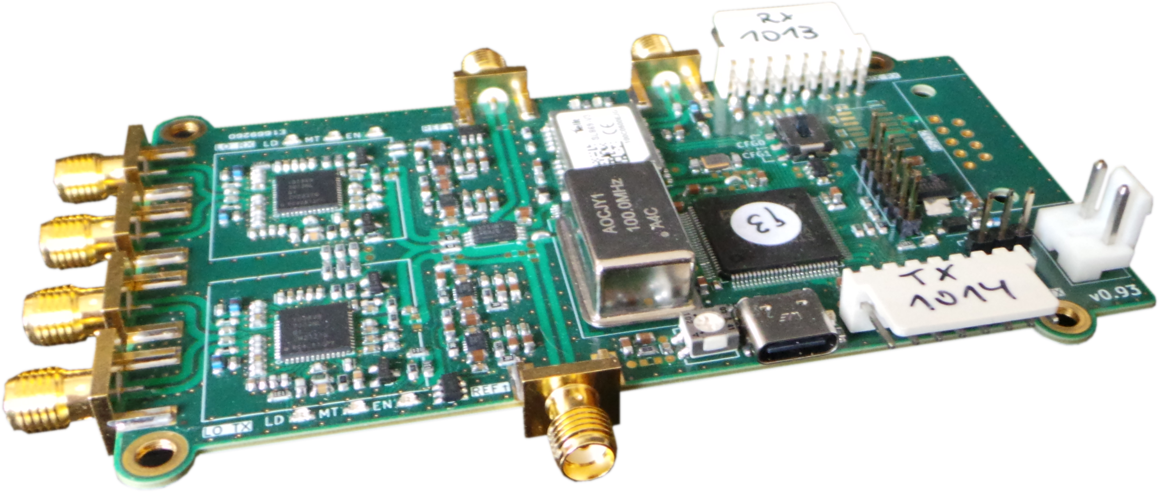
Antennas and RF frontend
Ground station based on 60 cm parabolic dish antenna
High gain: > 41 dB at 40 GHz
High pointing accuracy: < 1°
RF frontend based on commercial components and standard industry processes for low price point and easy manufacturability
Open system architecture for easy integration

Slide 30
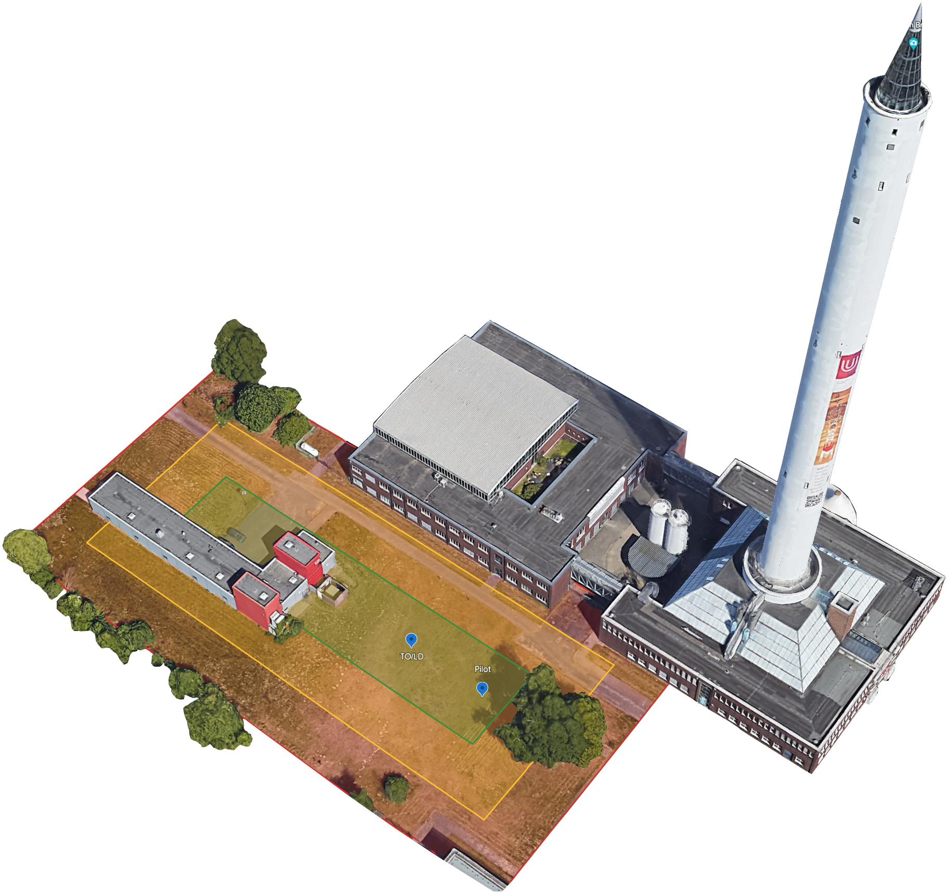
Testbed

Slide 31



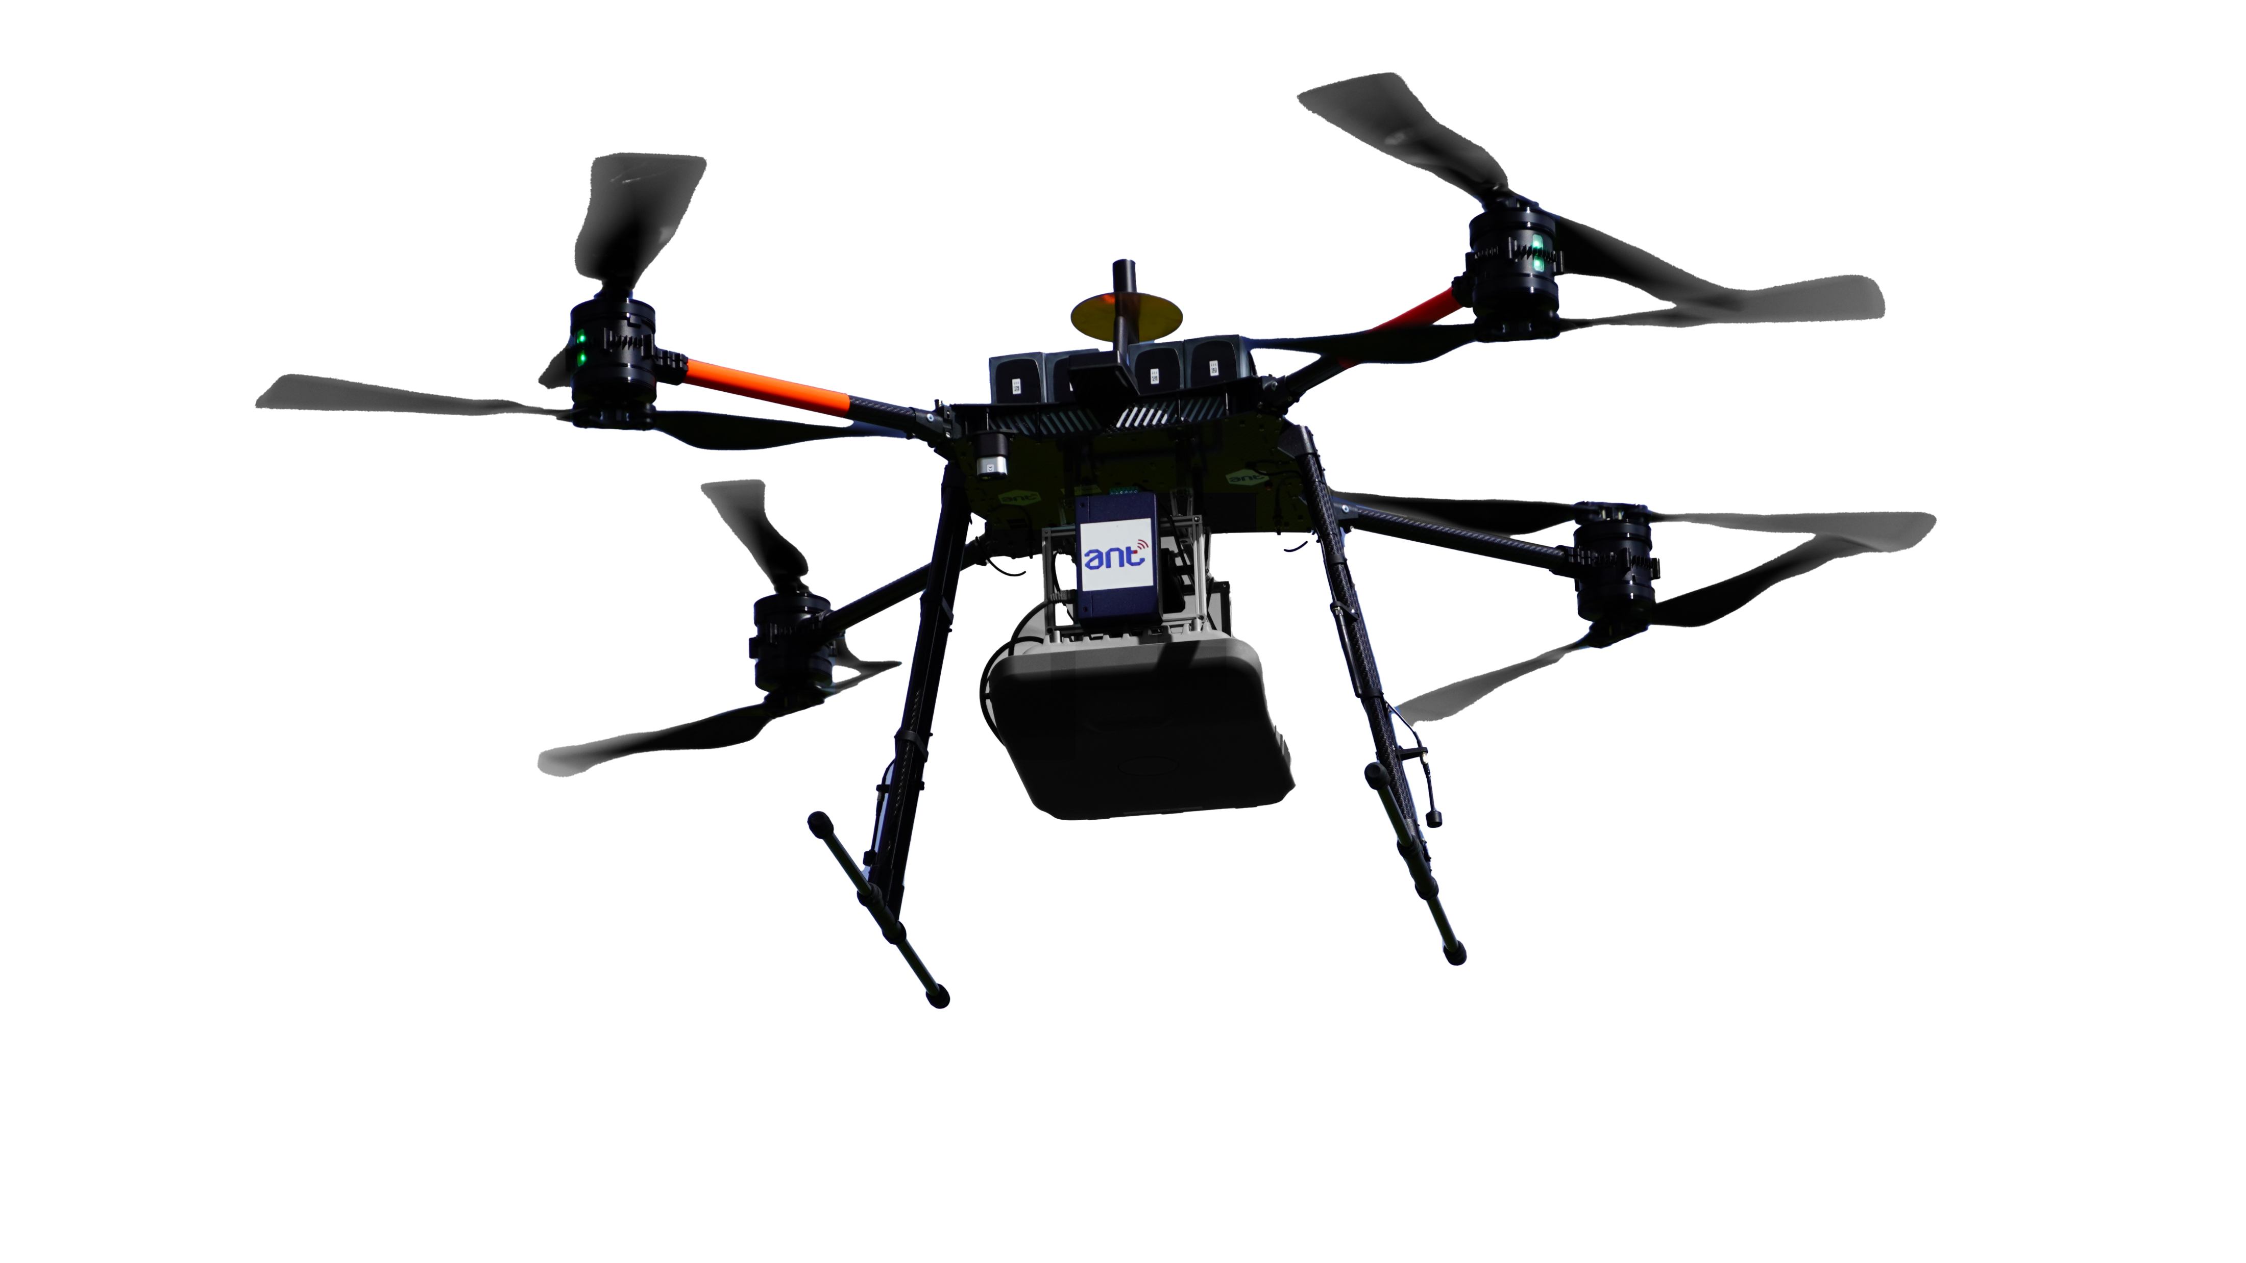
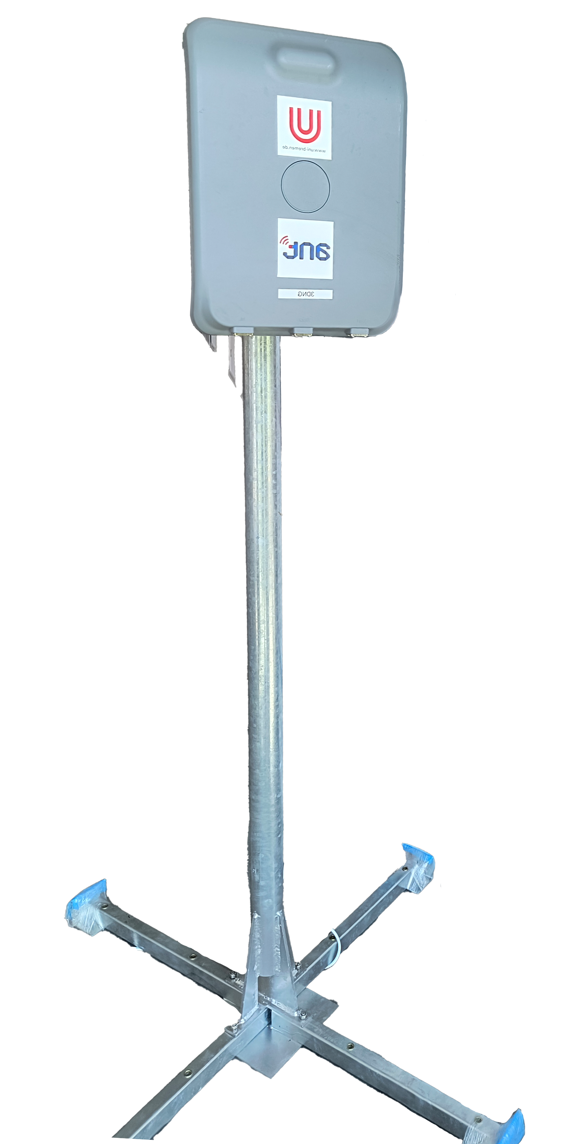
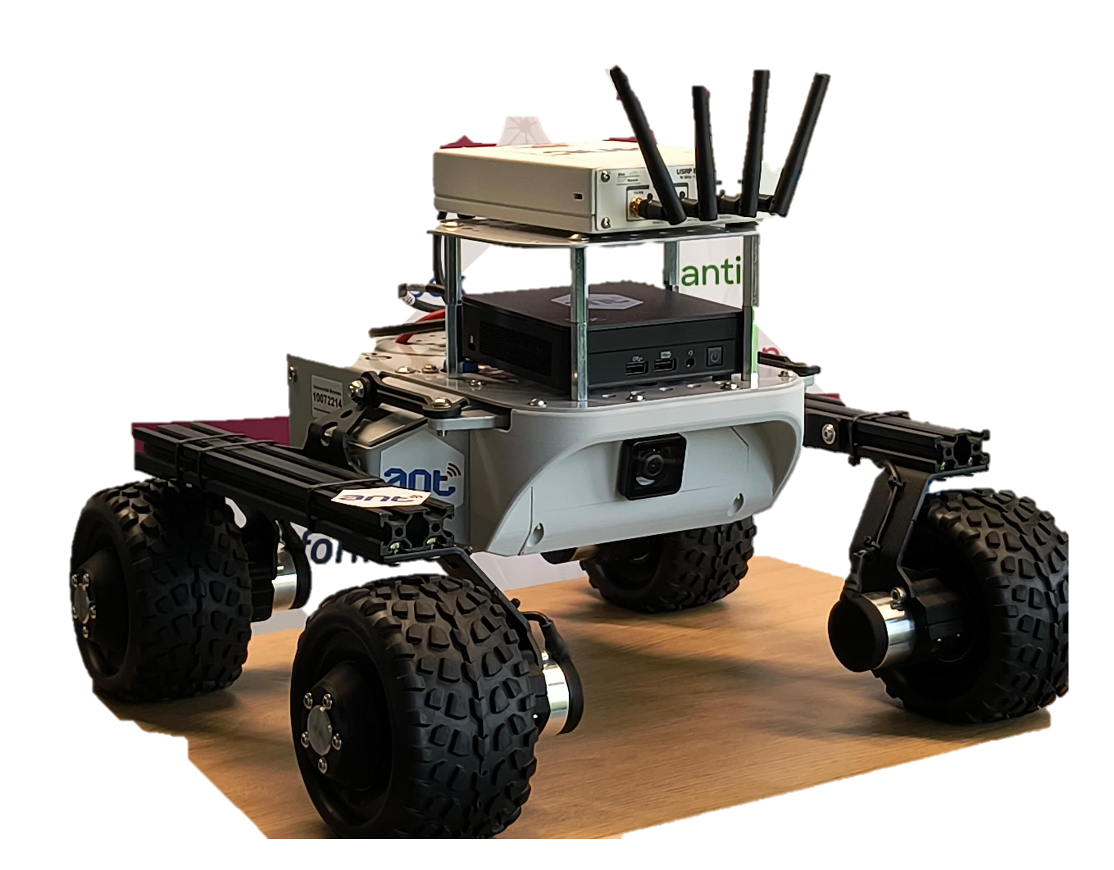
3D Experimental Field @ Uni Bremen
SDR mockup
LEO
satellite
SPACE
Connectivity provided by
in-orbit LEO satellites
& space-ready hardware
Security toolkit for 6G
Handover​
AIR
Drone provides connectivity on-demand
Multi-
connectivity
Flying
base station
Remote monitoring of
IoT devices via Satellite​
Terrestrial
base station
Rover with UE
GROUND
Public & Campus network integration
QoS measurement
& visualization ​
Resource
management​

Slide 32
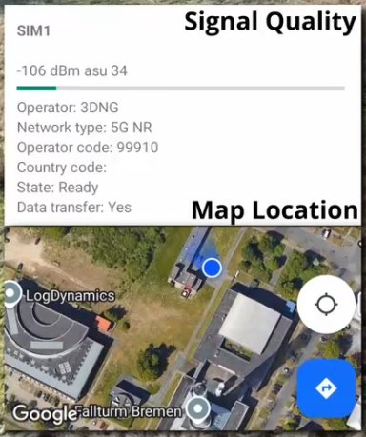
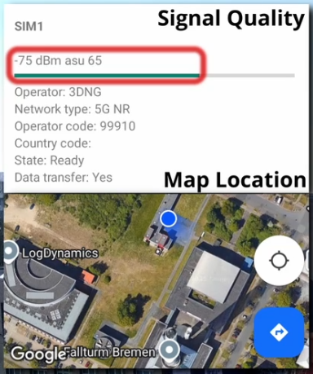
Extended On-Demand Coverage by Drone
Without drone
With drone
Flying BS helps restoring the signal quality, so coverage
UE uses the same SIM card, as a common core is used
Ground BS
Rover path
Drone BS
See booth

Slide 33







3D Multi-Access Edge Computing (MEC) for Smart Agriculture
MEC on NTN
  Ubiquitous coverage
  Ultra-Reliable Low Latency Services
  Radio Network Information for lower latency, higher reliability
Reliable Multicast
  Robust communication by packet level coding
Provisioning Server

Slide 34

BF-Antennas, Tracking Methods
Challenging requirements for beamforming antennas, UAV tracking algorithms, on-board units:
  Light-weight
  Energy-efficient
  Resistant to adverse environment
Demonstrations
  Testing of UAV tracking and beam steering
  by scaling down the flight path from the
  POV of the ground station
  Altitude, diameter of circular path reduced
  Angles and angular velocities stay the same
40 km
25 km
100 m

Slide 35
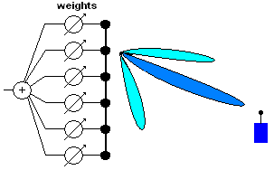

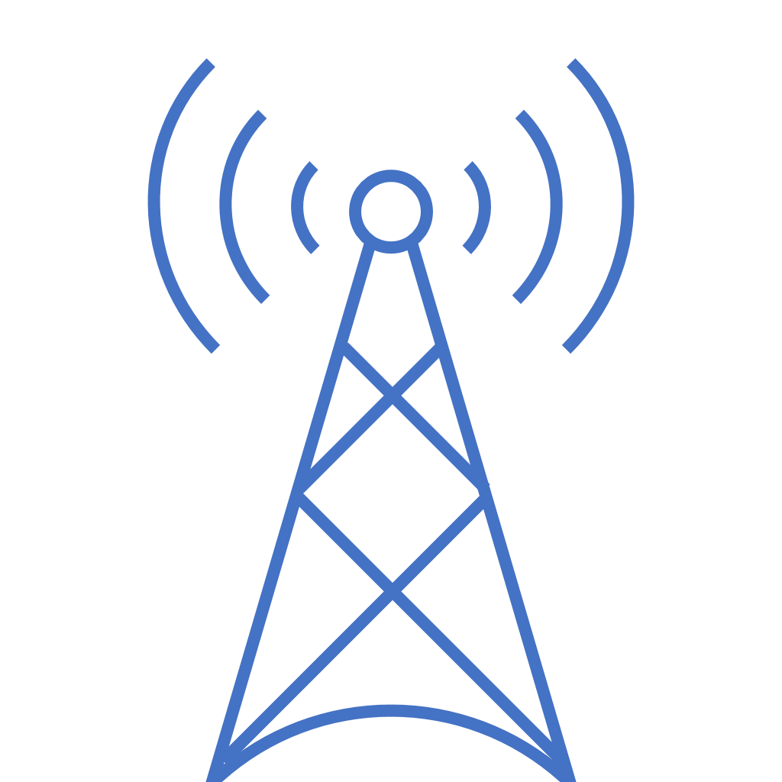

System Simulator Non-terrestrial Network (NTN)
System simulator = NTN in one box
Doppler shift
Time delay
Protocol enhancements
Mobility
Feeder Link
Service Link
Gateway
5G gNB
User Equipment (UE)
= Device under Test
5G core
Notes:
Customer has a UE/chip, we offer the rest (all in the CMX)

Slide 36

Research project
on
Holistic 3D Communication Networks for 6G
Contact:
info@6g-takeoff.de
https://www.6g-takeoff.de

